Slide 1
WSAC Decision Making Framework
Joint City Council and
Water Commission Meeting
April 10, 2018

Slide 2
WSAC made recommendations on what supply options to explore, how to make a decision about which option or portfolio of options to pursue, and set a timeline for when to make the decision

Slide 3
What:
Simultaneously explore two different approaches for supply augmentation to determine their technical feasibility, and to develop comparable information about costs, yields, time to implementation, energy use, and environmental impacts

Slide 4
The Two Strategies:
Strategy 1 – Groundwater Storage
Element 1 – In lieu recharge of local aquifers through water transfers and exchanges
Element 2 – Active recharge through aquifer storage and recovery
Strategy 2 – Other Local Sources Requiring Advanced Purification Technology
Element 3 – Advanced treated recycled water or desalinated water

Slide 5
How:
Use the information developed in the feasibility analysis work, as well as WSAC’s Guiding Principles and Key Decision-Making Metrics to conduct a quantitative and qualitative comparative analysis of all the options

Slide 6
How:
The goals of the WSAC’s decision-making framework are to:
Provide transparent, comparable information about all the options;
Create a level playing field for a robust decision-making process; and
Produce a decision that has the community support needed to enable implementation to proceed.

Slide 7
When:
Identify a preferred project or portfolio of projects to recommend to the City Council in late 2020
This timeline means that decision-making on a supplemental supply project or projects is about 2 years away

Slide 8
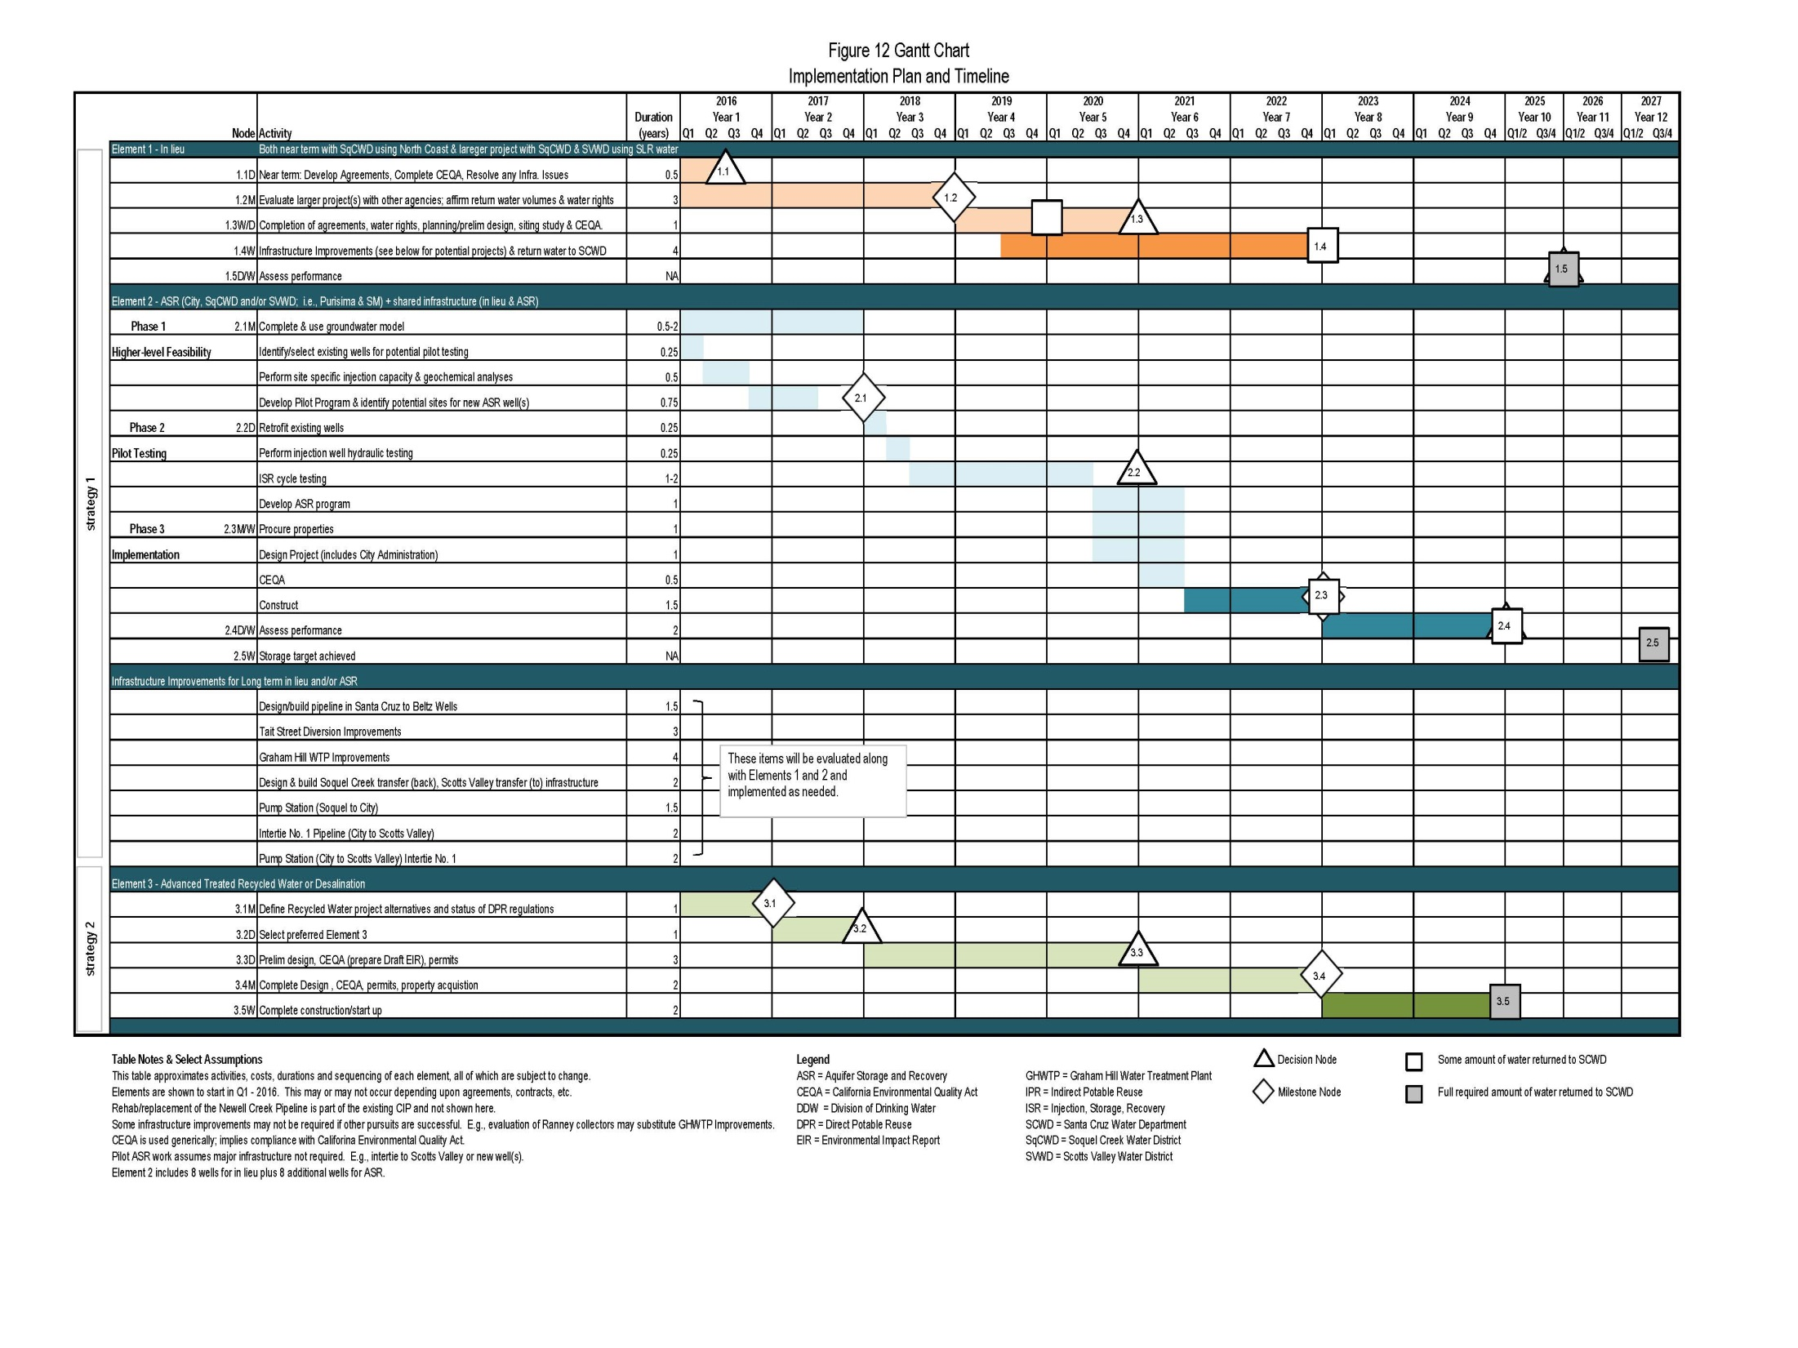

Slide 9
Elements of WSAC’s Decision-Making Framework:
Key Decision-Making Metrics
Guiding Principles
Preference Statements
Project Performance Metrics

Slide 10
Key Decision-Making Metrics:
Quantitative information for the three most important decision-making criteria.
WSAC’s Key Decision-Making Metrics include:
Cost
Yield
Timeliness

Slide 11
Key Metrics:
Cost
Choose to pursue groundwater storage strategies (Strategy 1) as long as the Annual Cost per million gallons of Average Year Yield (ACAYY) is not more than 130% of the ACAYY for Strategy 2 options and the groundwater strategies meet other threshold metrics.

Slide 12
Key Metrics
Yield
Preferred project(s) must produce the required yield of 1.2 billion gallons of water for the worst year shortage.
Timeliness
The preferred project(s) must be implemented to achieve water supply sufficiency within 10 years (i.e., 2025)

Slide 13
Guiding Principles:
Qualitative and value based statements of goals, preferences, or requirements that are to be considered in decision-making along with quantitative information.

Slide 14
WSAC’s Guiding Principles
Public Health
Consult with experts in public health, endocrinology and water chemistry on local water quality data related to preferred supply option(s).
Public Acceptance
Consider yield, cost, timeliness, technical feasibility, energy use, and environmental impacts of the various supply alternatives.

Slide 15
WSAC’s Guiding Principles
Regional Collaboration
Promote regional collaboration to improve regional water reliability.
Plan Goal
The selected preferred supply option(s) should meet the plan goal of meeting a 1.2 billion gallon shortage during worst year hydrology.
Incremental Implementation
Plan for incremental implementation to allow the City to avoid investing resources before they are needed and justified based on performance and other metrics.

Slide 16
WSAC’s Preferences and Values
Prefer groundwater storage strategies. Move away from these strategies only in the event that all reasonable steps to demonstrate technical feasibility of these strategies indicate that they cannot meet the plan goal or are exceeding key thresholds.
Prefer advanced treated recycled water over desalination.
Consider how preferred supply project(s) will contribute to system robustness, resiliency, redundancy and adaptive flexibility.

Slide 17
Project Performance Metrics:
Objective measures used in determining whether various plan elements are technically feasible.

Slide 18
Example Project Performance Metric for ASR:
Average injection capacity for a well must be at least 250 gpm.
Injection capacity less than 250 gpm results in needing to increase the number wells required to meet the Key Decision Making Metric for Yield and could result in an increased program costs that would negatively affect the Key Decision Metric for Cost.

Slide 19
 |  | Strategy 1 Element 1 – In Lieu | Strategy 1 Element 2 – ASR | Strategy 1 Combined In Lieu and ASR | Strategy 2 Element 3 – Purified Recycled Water | Strategy 2 Element 3 – Desalination
Threshold Metrics (quantitative indicators) | Technical Feasibility | Y/N | Y/N | Y/N | Y/N | Y/N
 | Cost (ACAYY) | Annual $/mg of yield | Annual $/mg of yield | Annual $/mg of yield | Annual $/mg of yield | Annual $/mg of yield
 | Yield | Billion gallons | Billion gallons | Billion gallons | Billion gallons | Billion gallons
 | Timeliness | Meets/Does Not Meet | Meets/Does Not Meet | Meets/Does Not Meet | Meets/Does Not Meet | Meets/Does Not Meet
Guiding Principles (qualitative, consumer report type indicators) | Public Health
 | Public Acceptance
 | Regional Collaboration
 | Plan Goal
 | Incremental Implementation
Additional Values | System Robustness
 | System Resilience
 | System Redundancy
 | Adaptive Flexibility

Slide 20
Qualitative results could be indicated with Consumer Report type symbols
Poor
Good

Slide 21
What’s Next?
Continuing to implement the work plan to produce the information needed for decision-making;
A Water Commission working group is assisting staff with further development of the comparative analysis framework;

Slide 22
The full Water Commission will be reviewing the working group’s recommendations in the months to come; and
Ultimately, the Water Commission will be making recommendations to the Council on the details of the decision-making approach for Council review and action.

Slide 23
QUESTIONS?

