Slide 1
Joint Meeting Santa Cruz City Council & Santa Cruz Water Commission April 10, 2018
Status after Second Year of Work Implementing the Recommendations of the Santa Cruz Water Supply Advisory Committee

Slide 2
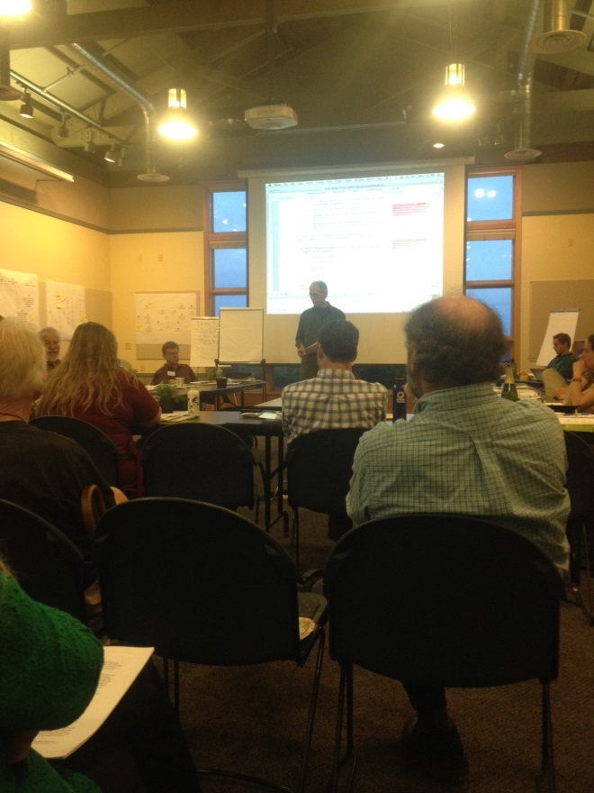
Background/Timeline
October 2013 City Council directed staff to develop a Community Engagement Program to address Santa Cruz’ water supply issues
November 2013 City Council accepts framework recommended by staff to establish a “Drought Solutions Citizen Advisory Committee”
February 2014 Council approves membership of the “Water Supply Advisory Committee”
April 2014 - October 2015 WSAC meets
November 10 and 24 2015 Joint Water Commission - City Council Study Session and Council adoption of WSAC Agreements and Recommendations

Slide 3
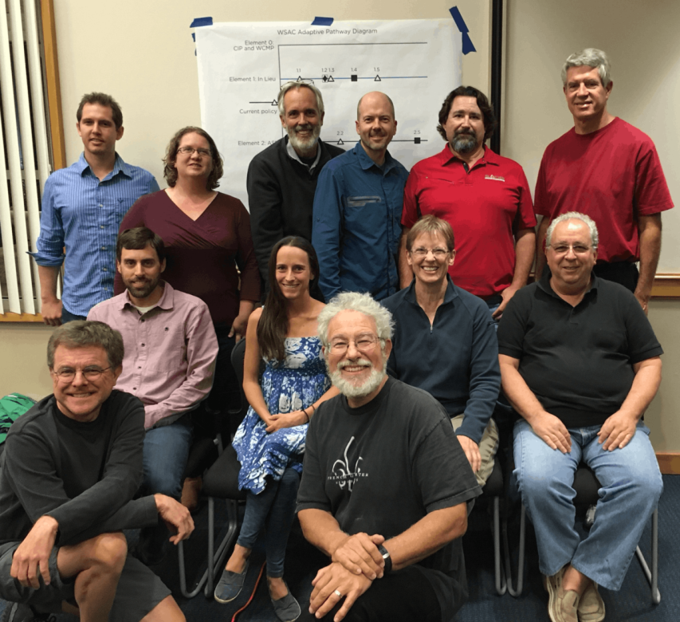
Water Supply Advisory Committee
14 Citizens of Santa Cruz and Live Oak
Appointed by Council
Representing the Chamber, Desal Alts, Sierra Club, Surfrider, Sustainable Water Coalition, the Water Commission and 3 community-at-large members.

Slide 5
WSAC’s Problem Statement July 2015
Limited Storage
Fish Flow Requirements & Potential climate change impacts
Resulting peak-season gap: 1.2 billion gallons worst case
Water conservation alone is not enough

Slide 6
WSAC Supply Augmentation Recommendations
Implement Additional Water Conservation Efforts
Continued and increased conservation programs
Explore the Feasibility of Winter Water Harvest
In-lieu water transfers/exchange with Soquel Creek and/or Scotts Valley Water Districts
Aquifer storage and recovery (ASR)
Explore the Feasibility of Alternative Water Supplies
Recycled water
Desalination

Slide 7
November 24, 2015 City Council Action on WSAC Agreements & Recommendations
Accepted the Water Supply Advisory Committee (WSAC) Agreements and Recommendations Final Report
Directed staff to integrate the WSAC-recommended water supply packaged strategy into the Urban Water Management Plan update, required by the Department of Water Resources to be submitted by July 1, 2016

Slide 8
In Lieu: Transfers & Exchanges
Concept: Water Transfers and/or Exchanges with Soquel Creek Water District, Scotts Valley Water District and/or San Lorenzo Valley Water District.
Founded by the work performed by Kennedy/Jenks for the County of Santa Cruz in 2013.
Kennedy/Jenks did not look at the ability of those agencies and the basins to return water. I.e., transfers only.
Signed agreement with Soquel Creek Water District in 2016 for the evaluation of the feasibility of water transfers. And we are currently looking at transfers & exchanges with groundwater modeling.
Hired Black & Veatch October 2017 to perform a pipe loop study.

Slide 9
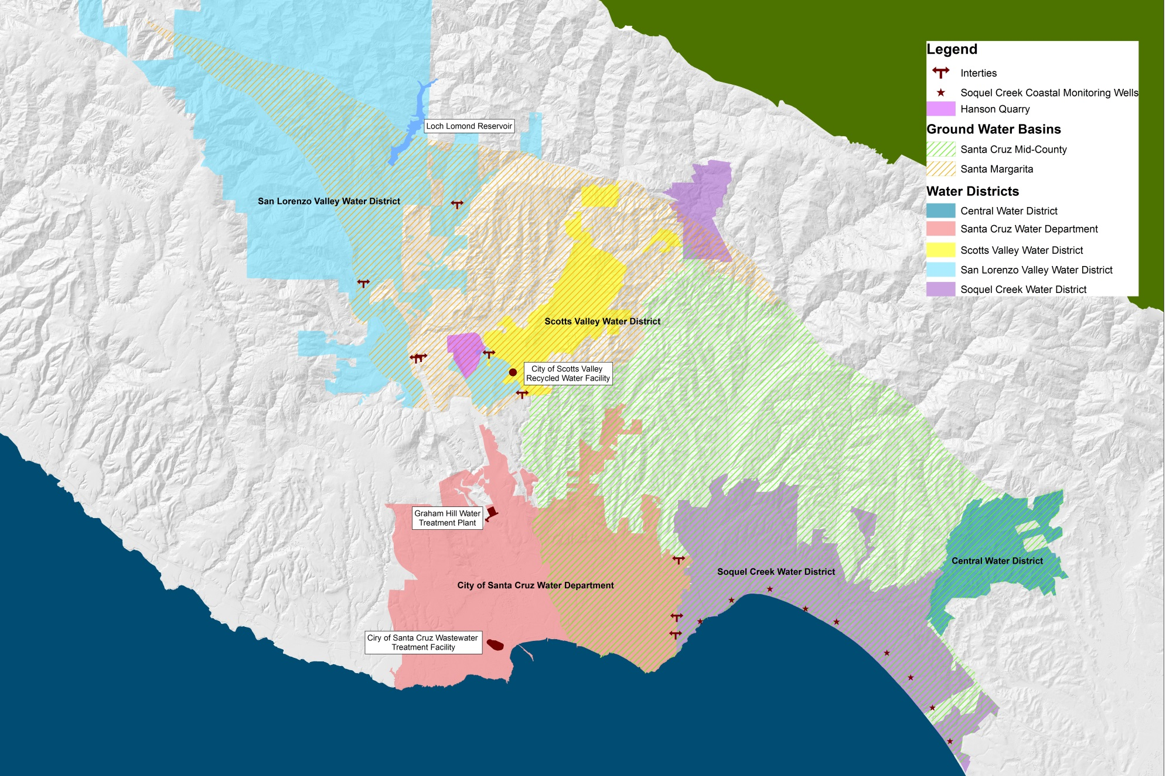

Slide 10
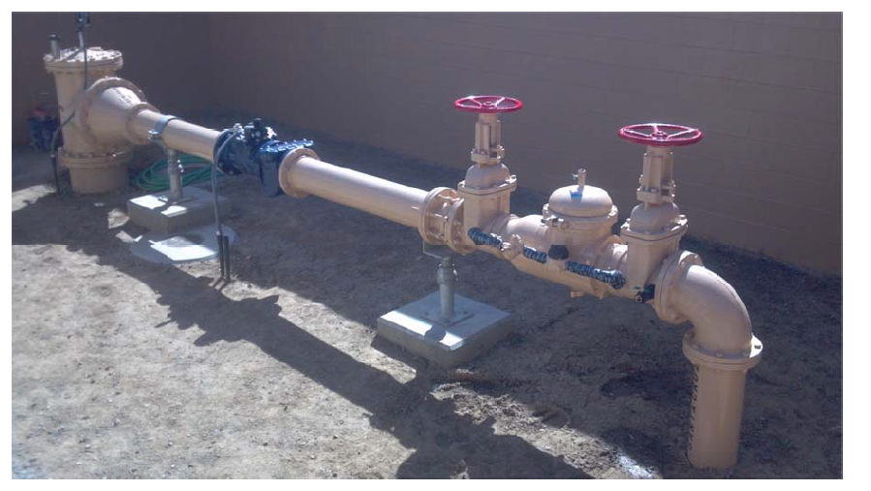
City/Soquel Intertie
Next Steps:
Results of first phase of pipe loop study due May 2018. Make decision about Phase 2.
Continue discussions with other agencies concerning their ongoing interest in water transfers.
Continue to refine groundwater modeling work to determine benefits to the basin(s) and ability to return water to Santa Cruz via an exchange.

Slide 11
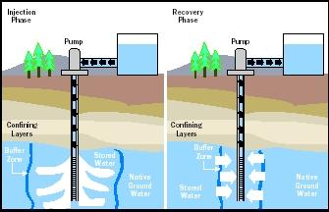
Aquifer Storage and Recovery
Concept: store water in aquifers for future use during drought.
Hired Pueblo Water Resources in February 2016 to complete feasibility analysis. (Phase 1)
Notes:
Discuss the three phases of this work.

Slide 12
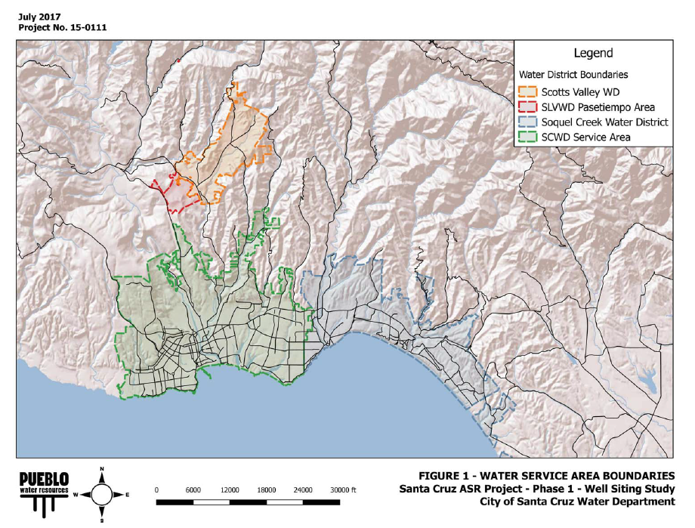
Aquifer Storage & Recovery
Progress to date:
Completed technical analyses
Evaluated existing wells for pilot testing
Performed siting study to establish locations of possible wells
Completing pilot test program
Ongoing groundwater modeling.

Slide 13
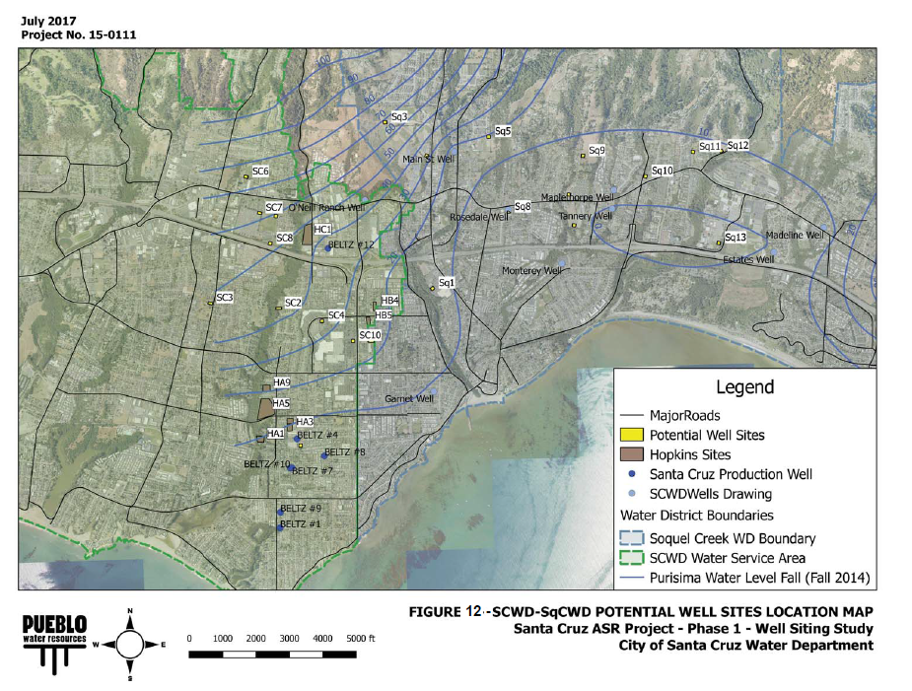
Aquifer Storage & Recovery Next Steps
Continue groundwater modeling
Develop and Implement Pilot Test Program (Phase 2)

Slide 14
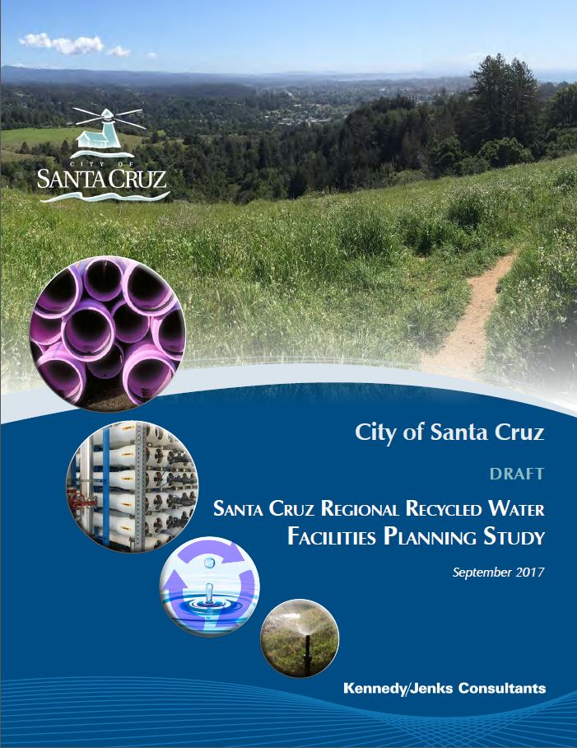
Recycled Water
Concept: Evaluate opportunities for beneficial use of treated wastewater.
Joint project: Public Works & Water.
Hired Kennedy Jenks February 2016 Evaluated ~40 alternatives for using recycled water.
Currently finalizing the study – June 2018.
Several projects recommended.

Slide 15
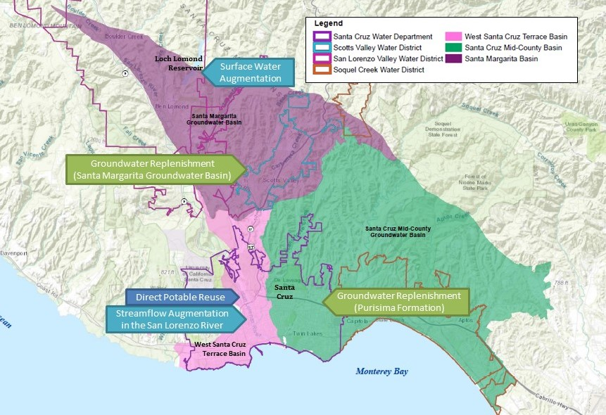
Recycled Water Alternatives Analyzed

Slide 16
Recycled Water Market Assessment

Slide 17
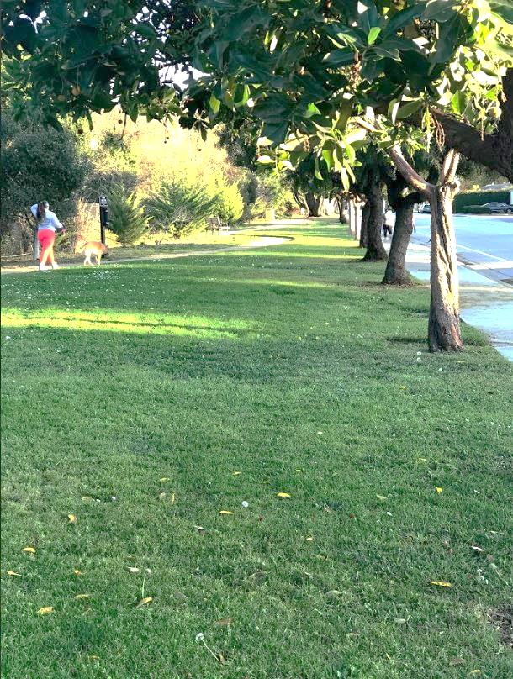
Recycled Water Recommended Projects
The recommended project is a phased approach…
In the near-term provide beneficial reuse through a small non-potable water project while leaving the door open for larger potable water offset through local or regional groundwater reuse replenishment projects in the future.

Slide 18
Recycled Water Recommended Projects
Santa Cruz Public Works Title 22 Project
Near-term non-potable reuse project to meet in-plant demands, develop a bulk water station and irrigate the La Barranca Park.
BayCycle Project
Expand the initial project to increase production to serve customers along Bay Street including UCSC.

Slide 19
Recycled Water Recommended Projects Other Reuse Opportunities
-Coordination with Pure Water Soquel
-Explore groundwater replenishment reuse in Mid-County Basin
-Explore groundwater replenishment reuse in Santa Margarita Basin

Slide 20
Seawater Desalination
Reviewed feasibility, costs, timeliness and approach for pursuing the final planning and design, construction and operation of a seawater desalination facility for use by the City as per the WSAC recommendations.
Assessed changed conditions since the pursuit of seawater desalination was suspended in 2013that may affect a possible City Seawater Desalination Project or influence potential environmental review and/or permitting requirements if such a project is pursued by the City.
Hired Dudek in May 2017 to conduct the Desalination Feasibility Update.

Slide 21
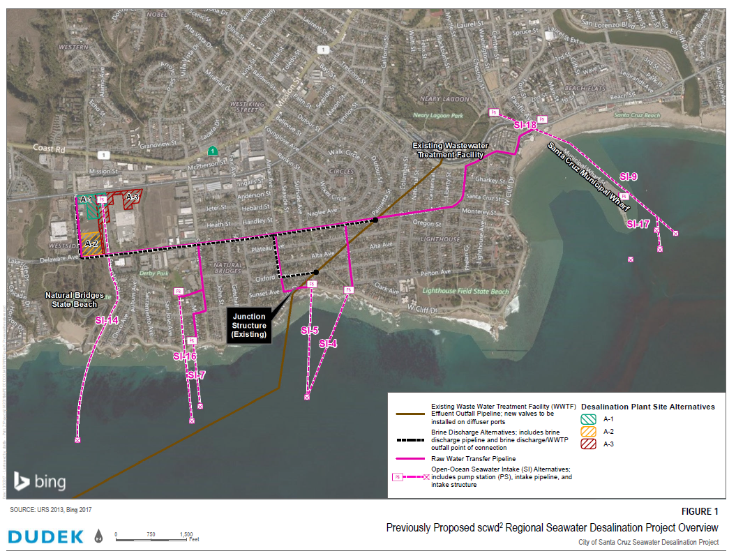
scwd2 Project Components

Slide 22
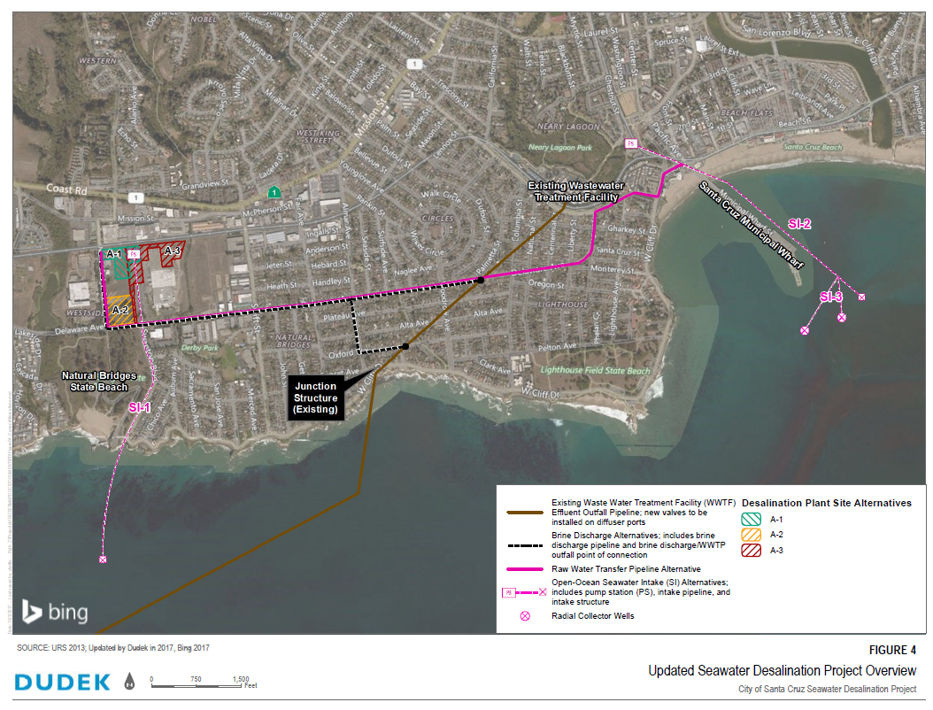
Seawater Desalination Project Reflecting Changed Conditions
Notes:
How did this approach

Slide 23
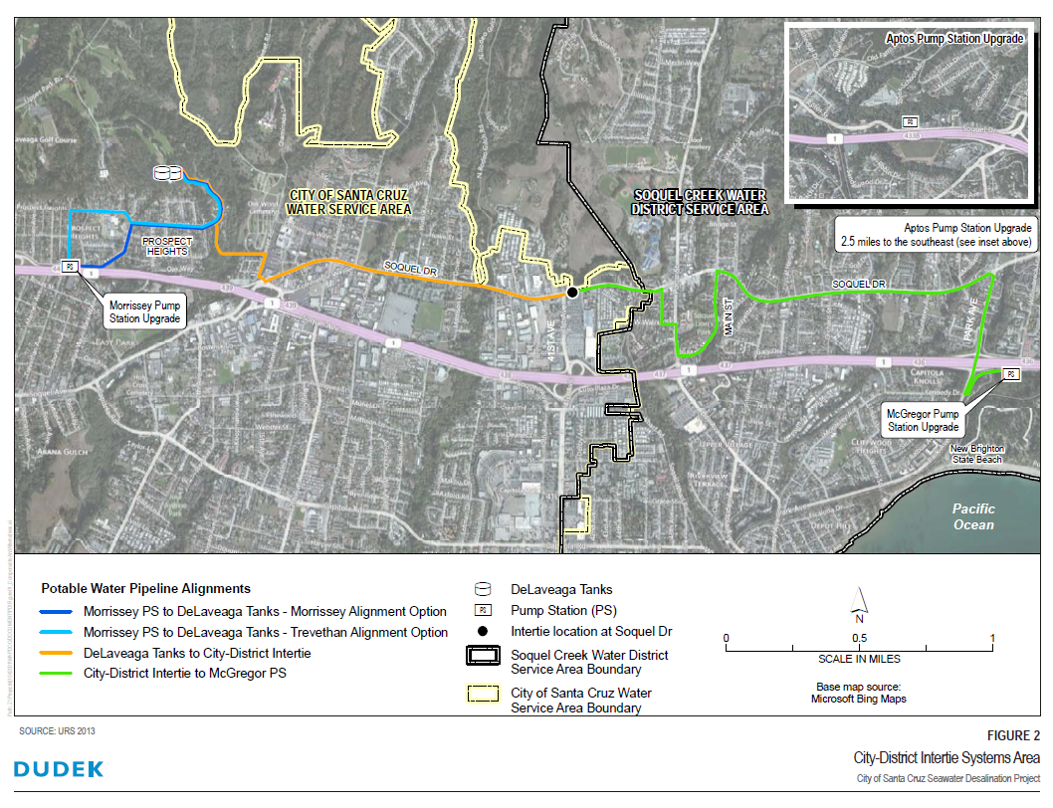

Slide 24
Seawater Desalination
Findings & Next Steps
Project can produce required yield of 1.2billion gallons per year.
Costs are refined based on changed conditions.
Timeliness of implementation like an issue due to new regulations.

Slide 25
What do we expect in CY2018?
In Lieu
Finalize Phase 1 of Pipe Loop Study
Possibly begin Phase 2
Possibly transfer water
ASR
Begin Piloting
Recycled Water
Complete study
Submit to SWRCB
Support SqCWD
Support Public Works
Continue evaluation of other projects
Desalination
Finalize Feasibility Update
Analyze all alternatives at the same level (cost, time, yield)
Continue ongoing studies: GHWTP, Operational Changes, NCP

Slide 26
QUESTIONS?

