Slide 1
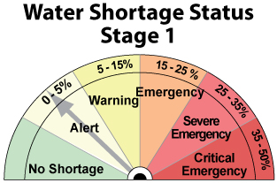
2018 Annual Water Supply and Demand Assessment
Notes:
Toby

Slide 2
2018 Wet Season Coming to a Close
Process: Annual water supply assessment conducted in 3 steps:
Initial water supply outlook – late January
Revised outlook – end of February
Final evaluation – late March
Purpose: to provide public an early indication of potential water restrictions
Schedule: allows for May 1 start

Slide 3
2018 - A Year of Contrasts
Follows wettest year on record
Ended 2017 with good reservoir storage
Relatively low rainfall this year
River flows below average all winter
2 winter months almost completely dry signaling a possible return of drought conditions
Wet March and early April

Slide 4
Factors that go into Annual Evaluation
Water Supply
Rainfall, in City and in watershed
Stream flows, habitat needs and availability for use
Reservoir storage
Cumulative runoff San Lorenzo River
Water Demand
Annual production level and trends in consumption
Forecast reservoir storage through Oct 2018 and evaluate carryover for 2019

Slide 5
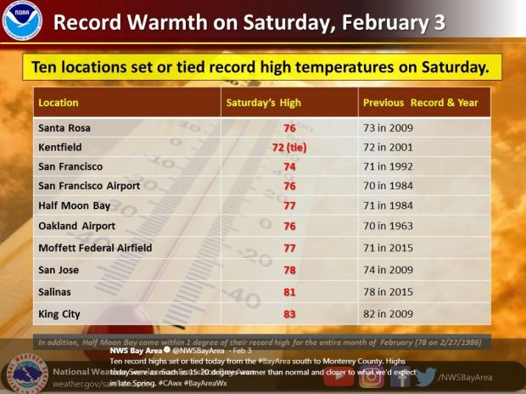
New Winter Temperature Records

Slide 6
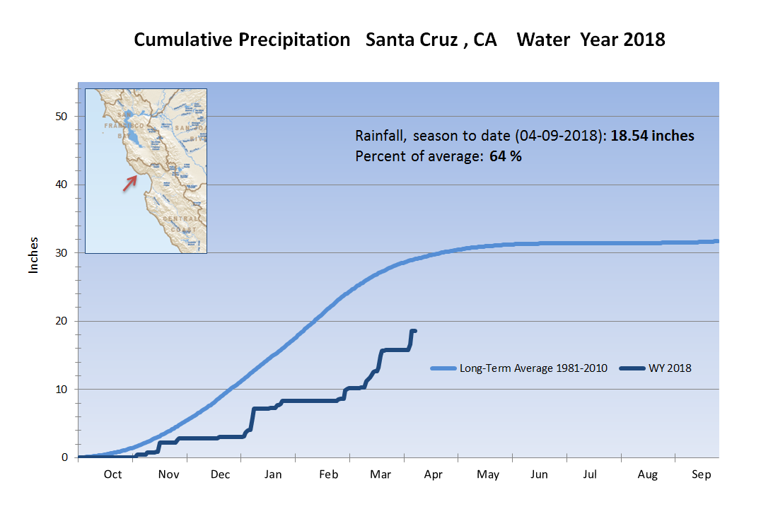
Cumulative Rainfall

Slide 7
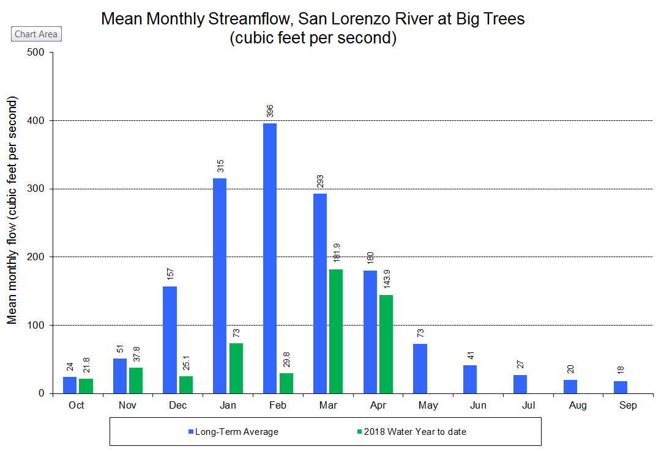
Monthly Stream Flow

Slide 8

Reservoir Storage
93.5% of capacity
Elevation 574.3’ above MSL

Slide 9
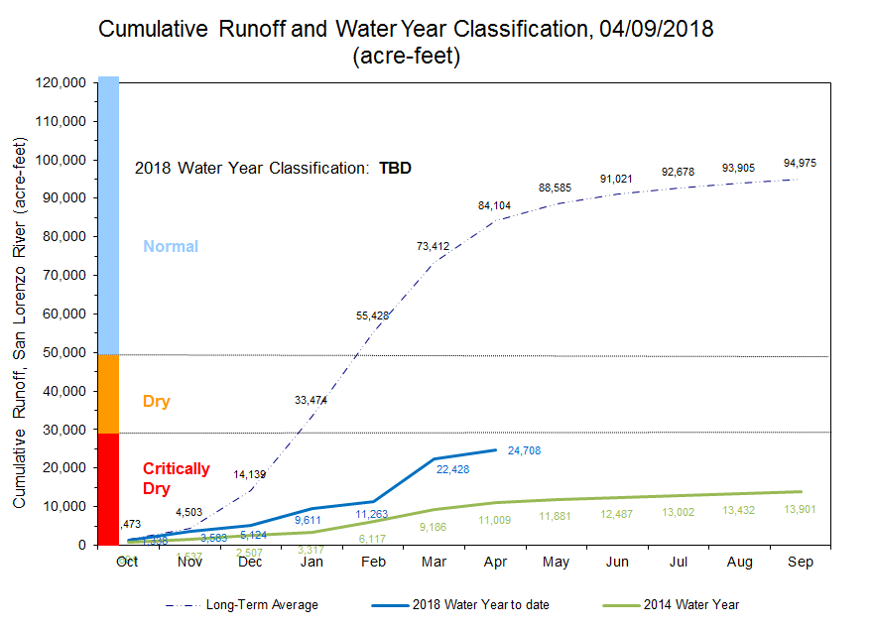
Cumulative Runoff

Slide 10
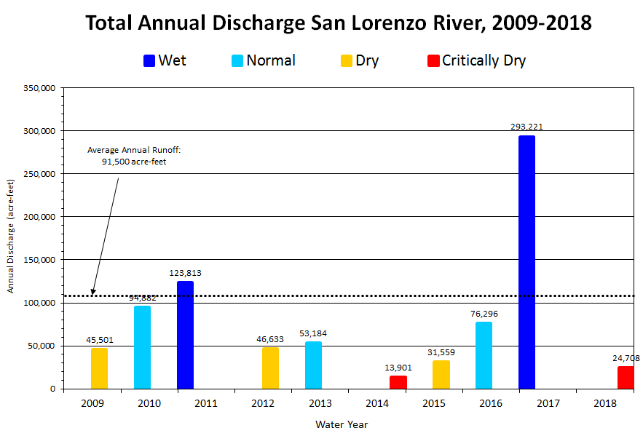
Cumulative Runoff – Last 10 Years

Slide 11
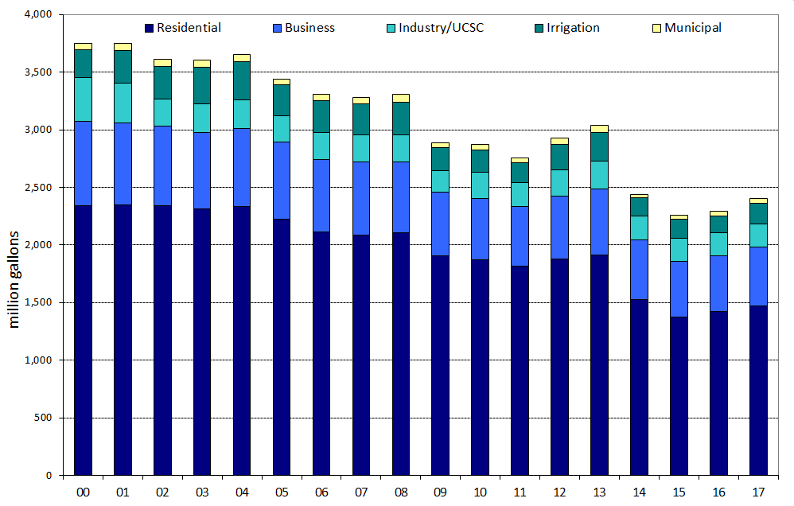
Water Consumption

Slide 12
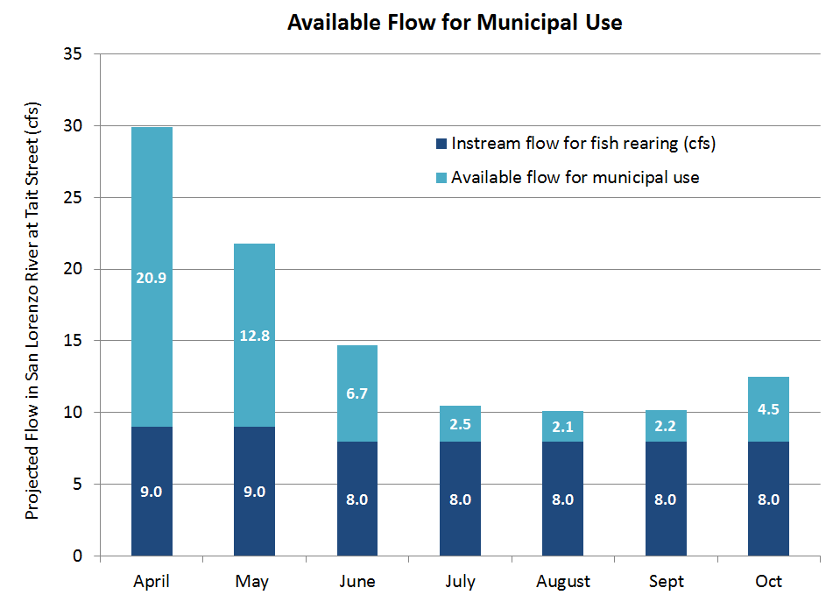

Importance of Maintaining Habitat

Slide 13
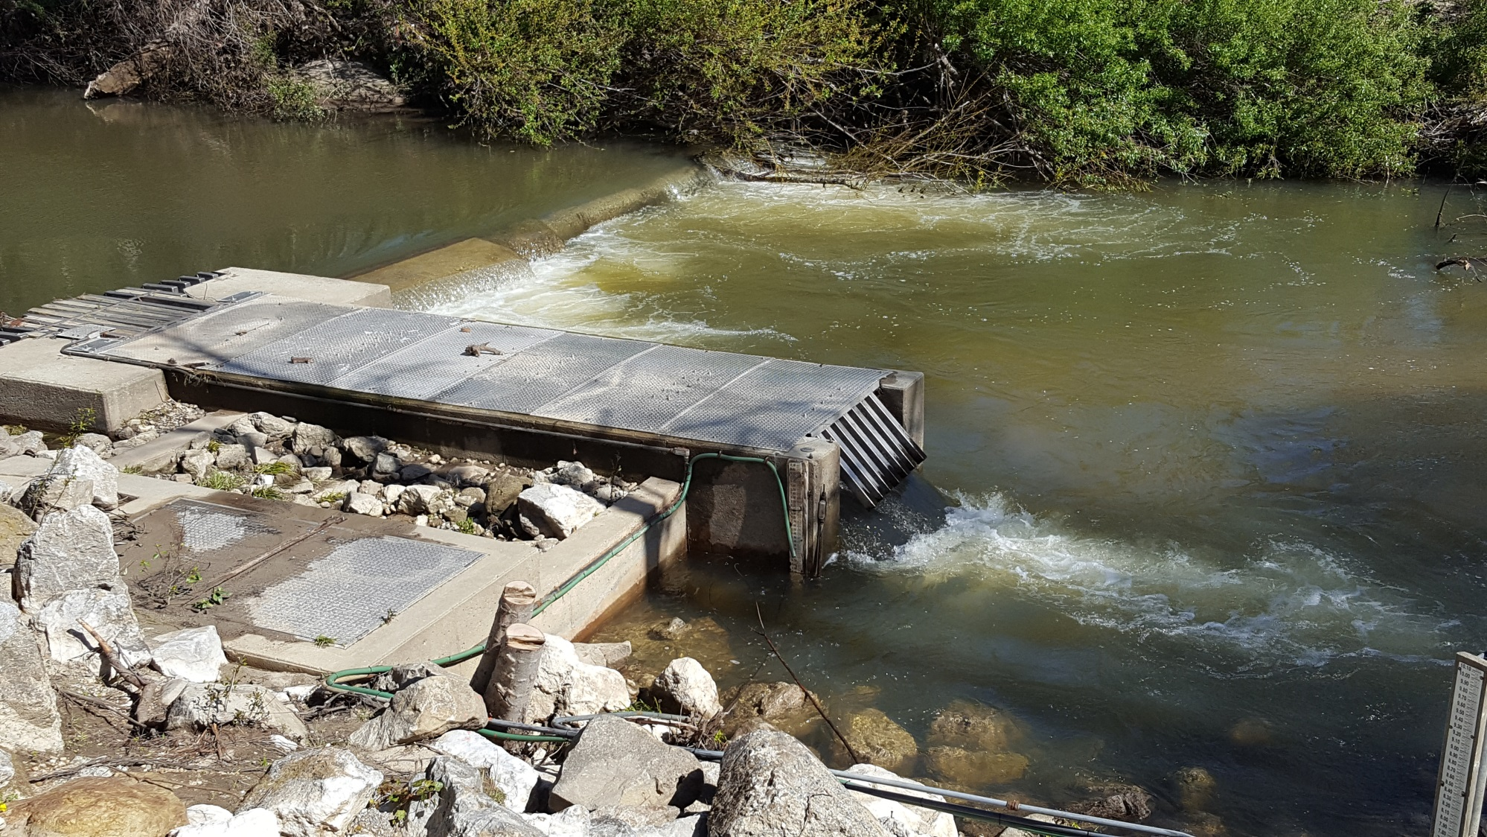
Bypass Flows at Tait Street Intake

Slide 14
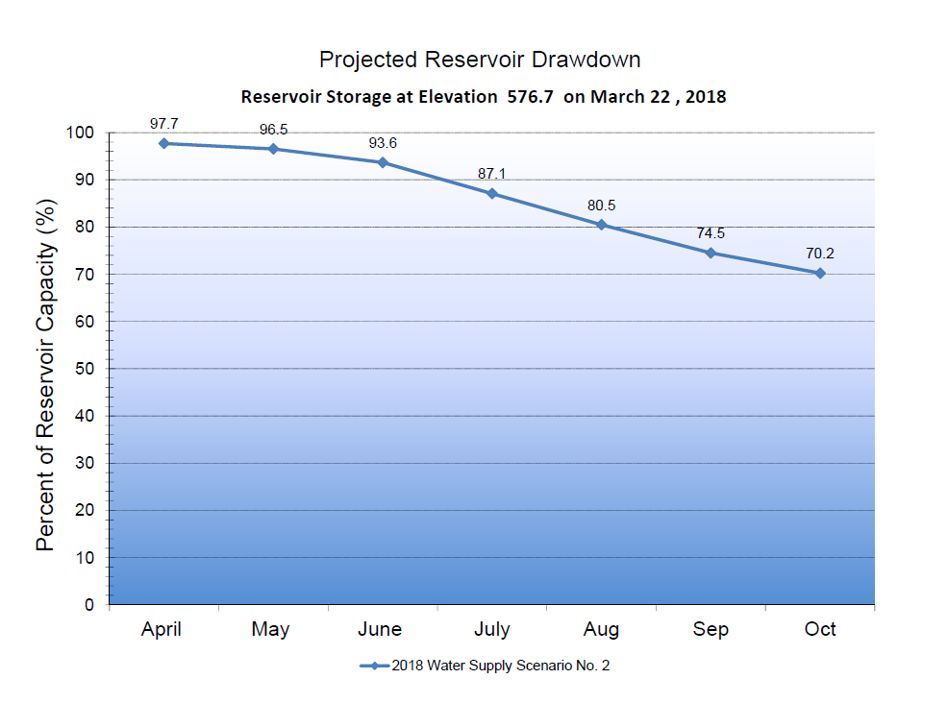
Projected Reservoir Drawdown

Slide 15
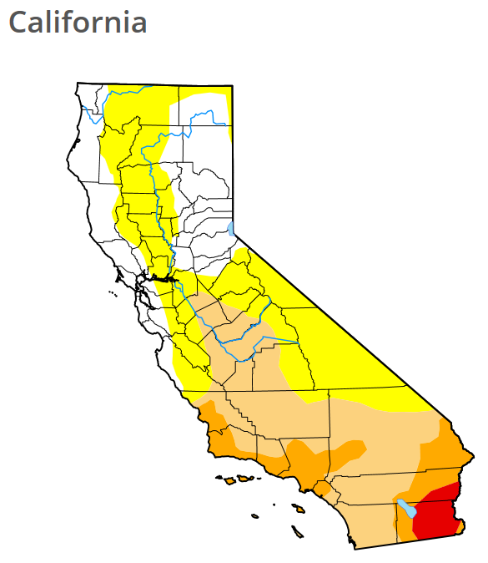
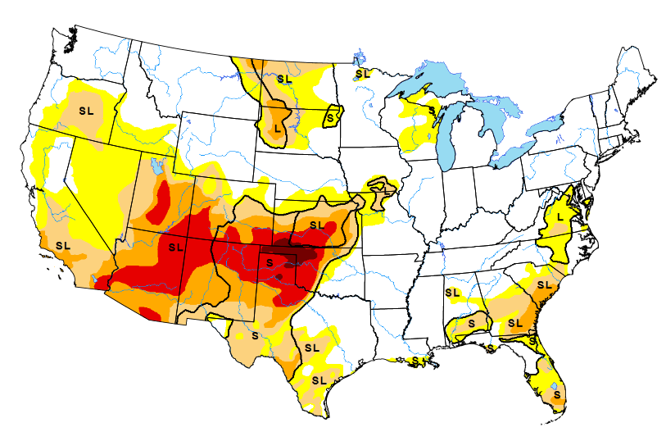
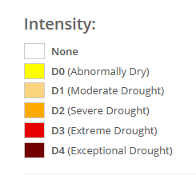
U.S. Drought Monitor: April 5, 2018

Slide 16
Recommendation:
City Council Adopt Resolution declaring Stage 1 Water Shortage Alert
May 1- October 31
Goal is to hold water consumption at 2017 levels
Voluntary water conservation requested by all customers;
Stepped up enforcement of water waste prohibitions, beginning with a written notice, followed by penalties: $100 up to $500

Slide 17
Stage 1 Prohibitions and Requirements:
Prohibitions on:
Landscape watering 10:00 a.m. and 5:00 p.m.
Outdoor washing of hard/paved surfaces, except to alleviate safety or sanitary hazards
Draining, refilling residential swimming pools
Requirements:
Shut-off nozzles required on all hoses
Water served on request only
Hotel, motel provide option to forego daily laundering

Slide 18

Questions?

