Slide 1
Current and Potential Future Supply and Demand in
Santa Cruz
Water Supply Advisory Committee
June 26-27, 2014

Slide 2
Presentation Overview
Introduction and Context
A Representational View of How Sources are Deployed to Meet Demand
Current Supply
Current Demand
Future Supply
Future Demand
Conclusions and Take Aways

Slide 3
Introduction and Context
The fundamental question the WSAC will have to grapple with in its work is the reliability of Santa Cruz’s water supply.
The fundamental measure for reliability is the degree to which available supply can meet existing and future demand under a range of foreseeable and unforeseeable but probable circumstances or conditions.

Slide 4
How Water Sources are Deployed to Meet Demand
A Representational View

Slide 5
Average Monthly
System Demand
Millions of Gallons per Day

Slide 6
Supply and Demand in
Average Conditions
Millions of Gallons per Day
North Coast

Slide 7
Supply and Demand in
Average Conditions
Millions of Gallons per Day
San Lorenzo River
North Coast

Slide 8
Supply and Demand in
Average Conditions
Millions of Gallons per Day
Live Oak Wells
San Lorenzo River
North Coast

Slide 9
Supply and Demand in
Average Conditions
Millions of Gallons per Day
Loch Lomond Reservoir
Live Oak Wells
San Lorenzo River
North Coast

Slide 10
Supply and Demand in a Drought
Millions of Gallons per Day

Slide 11
Supply and Demand in a Drought
Millions of Gallons per Day
North Coast

Slide 12
Supply and Demand in a Drought
Millions of Gallons per Day
San Lorenzo River
North Coast

Slide 13
Supply and Demand in a Drought
Millions of Gallons per Day
Live Oak Wells
San Lorenzo River
North Coast

Slide 14
Supply and Demand in a Drought
Millions of Gallons per Day
Loch Lomond Reservoir
Live Oak Wells
San Lorenzo River
North Coast

Slide 15
Supply and Demand in a Drought
Millions of Gallons per Day
Deficit
Loch Lomond Reservoir
Live Oak Wells
San Lorenzo River
North Coast

Slide 16
The Role of Curtailment

Slide 17
Curtailment is a strategy used to respond to short term supply deficiencies
The 2009 Water Shortage Contingency Plan, sets the following overarching goals:
  To conserve the water supply of the City for the greatest public benefit;
  To mitigate the effects of a water supply shortage on public health and safety, economic activity, and customers lifestyle; and
  To budget water use so that supply will be available for the most essential purposes for the entire duration of the water shortage.

Slide 18
The Water Shortage Contingency Plan
Uses a Priority-Based Allocation System
When a shortage occurs, available water supply is classified into 3 usage priorities:
Priority | Type of Water Use
Highest | Health and safety: Indoor domestic use for personal care
Next highest | Business (protect jobs/economy)
Lowest | Landscape, yard, or garden irrigation and other outdoor uses

Slide 19
Table ES-3. Water Supply Allocation and Customer Reduction Goals
 | No Deficiency |  | Stage 2 15% Deficiency |  | Stage 3 25% Deficiency |  | Stage 4 35% Deficiency |  | Stage 5 50% Deficiency
 | Delivery |  | Delivery |  | Delivery |  | Delivery |  | Delivery
Normal Peak Season Demand = 2,473 mil gal | % | Volume (mil gal) | % | Volume (mil gal) | % | Volume (mil gal) | % | Volume (mil gal) | % | Volume (mil gal)
Single Family Residential | 100 | 1,031 | 84% | 864 | 73% | 753 | 62% | 639 | 48% | 495
Multiple Residential | 100 | 524 | 87% | 454 | 78% | 411 | 69% | 361 | 55% | 287
Business | 100 | 438 | 95% | 416 | 92% | 402 | 87% | 381 | 70% | 307
UC Santa Cruz | 100 | 132 | 85% | 113 | 76% | 100 | 66% | 87 | 52% | 68
Other Industrial | 100 | 23 | 95% | 22 | 90% | 21 | 85% | 20 | 67% | 15
Municipal | 100 | 48 | 76% | 36 | 57% | 27 | 41% | 20 | 28% | 14
Irrigation | 100 | 110 | 64% | 70 | 34% | 37 | 12% | 13 | 0% | 0
Golf Course Irrigation | 100 | 106 | 73% | 78 | 51% | 54 | 34% | 36 | 20% | 21
Coast Agriculture | 100 | 59 | 95% | 56 | 90% | 53 | 85% | 50 | 67% | 40
Other | 100 | 2 | 95% | 2 | 90% | 2 | 50% | 1 | 50% | 1
Total | 100 | 2,473 | 85% | 2,111 | 75% | 1,861 | 65% | 1,607 | 50% | 1,247
Demand Reduction %, Million gallons | 0 | 0 | 15% | -362 | 25% | -612 | 35% | -866 | 50% | -1,226

Slide 20
Current Supply

Slide 21
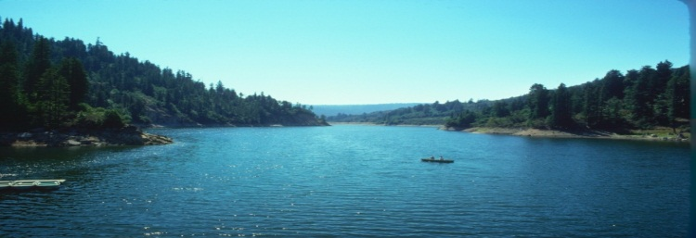
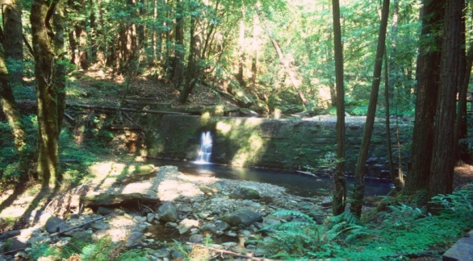
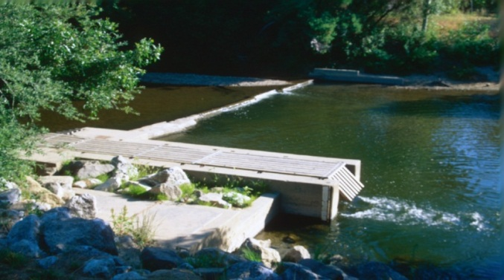
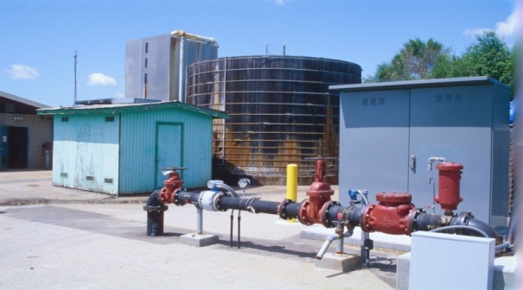
Water Sources
Tait Wells
Loch Lomond Reservoir (1960)
Loch
3%
North Coast
Lomond
Streams
North Coast Streams (1890)
22%
25%
Beltz Wells (1964)
Beltz Wells
San Lorenzo River (1924)
4%
San Lorenzo
River
46%

Slide 22
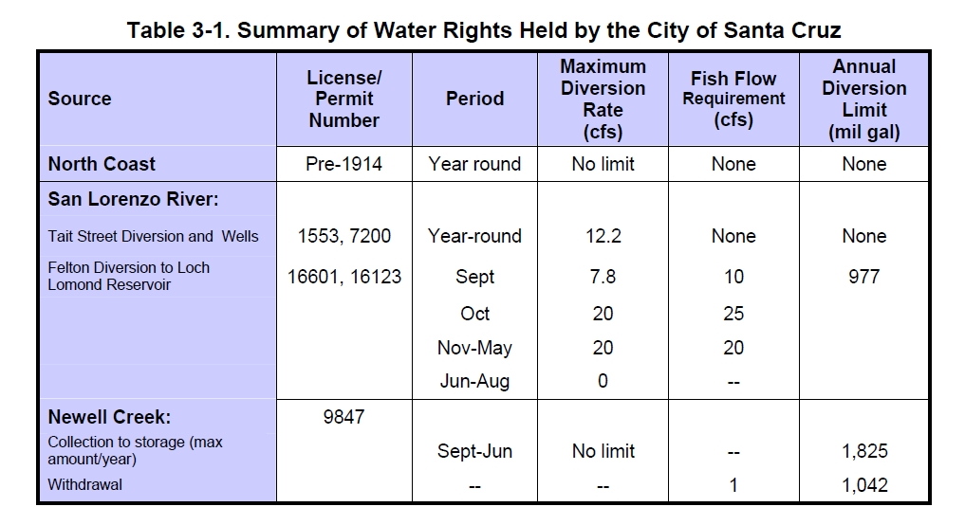
City of Santa Cruz Water Rights

Slide 23
Gross Water Supply Sources for the City of Santa Cruz’s Water Utility, 2009-2013
 | Calendar Year All figures in million of gallons
Source | 2009 | 2010 | 2011 | 2012 | 2013
Coastal Sources | 814 | 1,168 | 1,211 | 711 | 400
San Lorenzo River | 2,038 | 1,468 | 1,465 | 1,959 | 2,110
Loch Lomond | 195 | 411 | 228 | 462 | 807
Beltz Wells | 165 | 145 | 163 | 163 | 160
Totals | 3,212 | 3,192 | 3,067 | 3,295 | 3,477

Slide 24
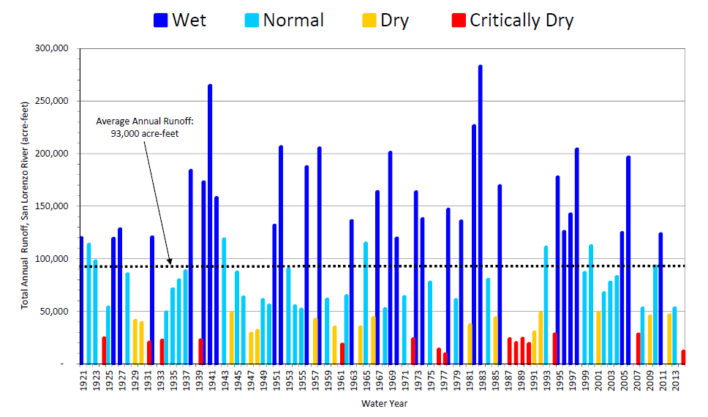
Annual runoff from the San Lorenzo River is highly variable
1 acre foot = 325,851.427 gallons

Slide 25
Annual Production by Source

Slide 26
Monthly Production by Source, 2012

Slide 27
Monthly Production by Source, 2013

Slide 28
Short Term Flow Agreements
For several years, the Water Department has negotiated short term (6 month window) flow agreements with the California Department of Fish and Wildlife and the NOAA National Marine Fisheries Service;
The flows agreed to are designed to address the flow needs of the fish species and life stages that are relevant during that 6 month window; and
The flow agreements are specifically agreed not to be precedent setting for either party.

Slide 29
Current Demand

Slide 30
Why do we see so many different numbers for production and demand?
Gross production is all the water that is taken into the system, and includes raw water sales and raw water system losses
Net Production is all the water that goes through the GHWTP + Beltz Wells and includes system uses (e.g., flushing) and losses
Metered water consumption includes potable water sales billed to customers
Calendar year 2013 data: gross production = 3.477 in billions of gallons

Slide 32
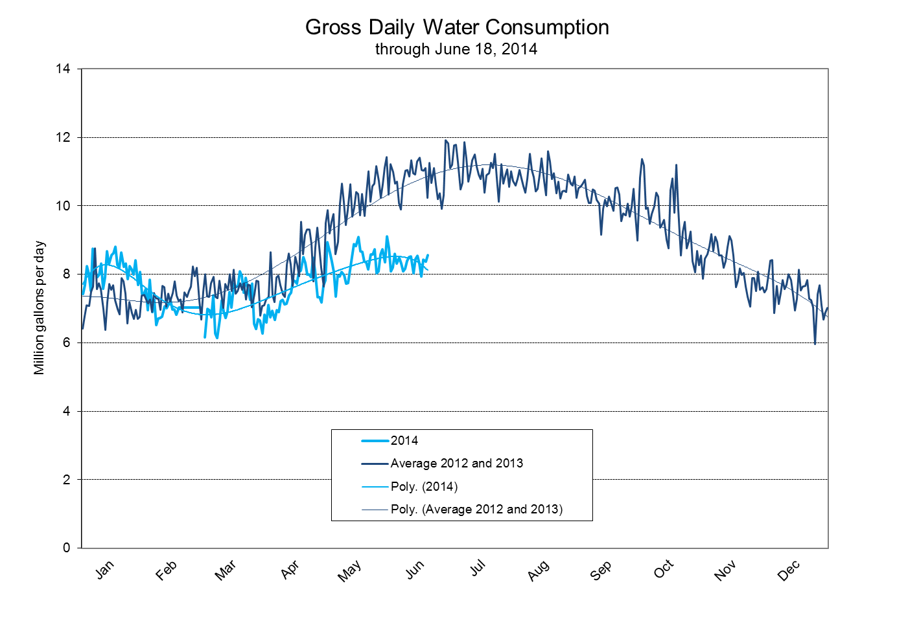

Slide 33
Annual Metered Water Consumption

Slide 34
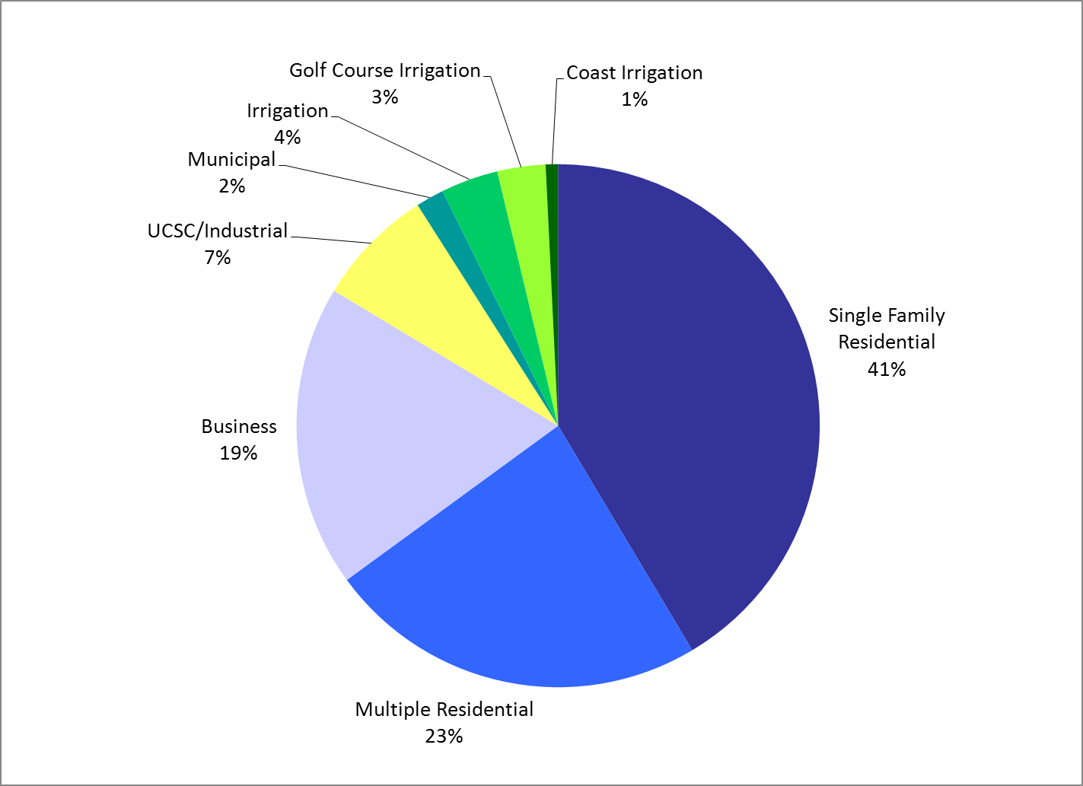
Metered Water Use by
Customer Category

Slide 35
Gallons per capita per day
2010 Urban Water Management Plan Figure 4-5 as augmented by additional data

Slide 36
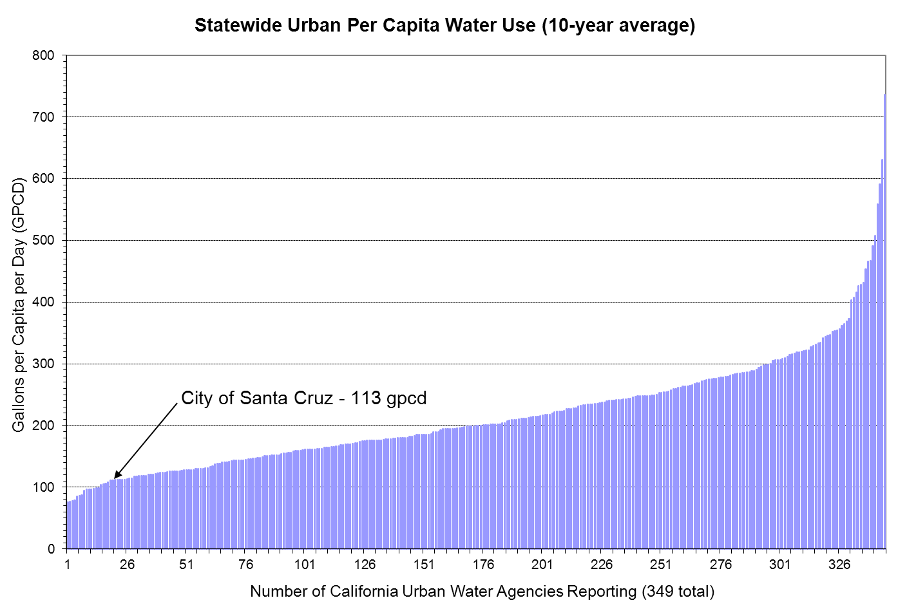
Average Per Capita Water Use
2001-2010
City of Santa Cruz today – 97 gpcd

Slide 37
Customer Characteristics

Slide 38
Customer Accounts Broken Down by Type and Geographic Area
Calendar Year 2013
Customer Class | Inside City | Capitola | North Coast | Outside City | Total
Single family | 12,212 | 134 | 22 | 6,590 | 18,958
Multi-family | 1,788 | 5 | 8 | 930 | 2,731
Irrigation residence | 127 | 3 | - | 70 | 200
Irrigation business | 118 | 18 | - | 116 | 252
Bulk/Hydrant meters | 31 | - | - | 1 | 32
North Coast Irrigation | - | - | 28 | - | 28
Irrigation golf | 1 | - | - | 5 | 6
Construction | 64 | - | 1 | 3 | 68
Business general | 1,077 | 72 | 10 | 542 | 1,701
Business restaurant | 102 | 2 | - | 2 | 106
Hotel/motel | 79 | 2 | - | 4 | 85
Industrial | 31 | - | - | 7 | 38
UC Santa Cruz | 11 | - | - | - | 11
City of Santa Cruz | 210 | - | 3 | 5 | 218
Total | 15,851 | 236 | 72 | 8,275 | 24,434

Slide 39
Water Consumption by Customer Class and Geographic Location
Calendar Year 2013 Figures are in millions of gallons
Customer Class | Inside City | Capitola | North Coast | Outside City | Total
Single family | 764 | 9 | 2 | 451 | 1,266
Multi-family | 366 | 4 | 2 | 319 | 690
Irrigation residence | 28 | <1 | - | 15 | 44
Irrigation business | 38 | 4 | - | 33 | 75
Bulk/Hydrant meters | 2 | - | - | - | 2
North Coast Irrigation | - | - | 24 | - | 24
Irrigation golf | 45 | - | - | 63 | 108
Construction | 1 | - | - | - | 1
Business general | 249 | 30 | 4 | 169 | 452
Business restaurant | 38 | 1 | - | 1 | 40
Hotel/motel | 70 | 8 | - | 2 | 80
Industrial | 55 | - | - | 1 | 56
UC Santa Cruz | 182 | - | - | - | 182
City of Santa Cruz | 61 | - | <1 | 1 | 62
Total | 1,899 | 56 | 32 | 1,055 | 3,043

Slide 40
Indoor/Outdoor Breakdown (%)
Category | Indoor | Outdoor
Single Family | 77 | 23
Multi-family | 88 | 12
Business | 79 | 21
UCSC | 77 | 23
Municipal | 32 | 68
Irrigation | 0 | 100
Golf | 0 | 100

Slide 41
End Use Breakdown
Typical Single Family Account

Slide 42
Baseline Conservation Survey:
Summary of Key Findings for
Single Family Residential Accounts
Item | Standard | No. surveyed | Average per household | Percent water efficient
Faucets | 2.2 gpm | 352 | 3.5 | 83%
Showerheads | 2.5 gpm | 176 | 1.8 | 92%
Toilets | 1.6 gpf | 208 | 2.1 | 90%
Clothes Washers | Type | 96 | 0.96 | 62%
Dishwashers | Age | 81 | 0.81 | 65%

Slide 43
Baseline Conservation Survey:
Summary of Key Findings for
Multi-Family Residential Accounts
Item | Standard | No. surveyed | Average per household | Percent water efficient
Faucets | 2.2 gpm | 322 | 2.4 | 87%
Showerheads | 2.5 gpm | 152 | 1.2 | 95%
Toilets | 1.6 gpf | 181 | 1.3 | 89%
Clothes Washers | Type | 44/109 | 0.4/0.08 | 58/46%
Dishwashers | Age | 49 | 0.4 | 45%

Slide 44
Lot Characteristics
 | Single Family | Multi-Family | Commercial (includes Schools)
Mean Lot Size (sq. ft.) | 8,574 | ~50,000 | ~104,450
Median Lot Size (sq. ft.) | 6,316 | 9,600 | 14,810
Sites with Landscaping | 98% | 73% | 54%
Average Lot Area in Landscaping sq. ft. (%) | 1,884 (22%) | 5,800 (12%) | 4,835 (5%)
Sites with Turf | 48% | 51% | 15%
Average Turf Area (sq. ft.) | 542 | 2,744 | 3,005

Slide 45
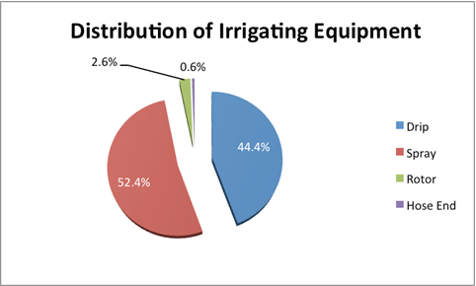
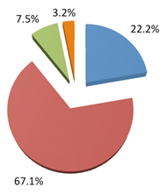
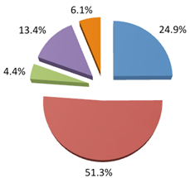
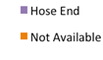
Irrigation Characteristics
Types of Irrigation Equipment
Single Family Multi-Family Commercial

Slide 46
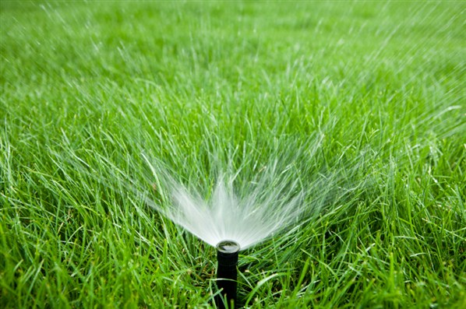

Turf and Irrigation Characteristics
Watering Turf with In-Ground Irrigation System
Single Family | Multi-Family | Commercial
62.5% | 71.2% | 74.4%

Slide 47
Future Supply

Slide 48
Supply Modeling
Confluence Model Inputs
  Hydrology
  Operating rule curves for various sources
  System demand – by customer class
  Water rights constraints
  Models aren’t static, as you learn more about the system and how the model forecasts it, questions and issues are identified that are researched and result in refining the model. This continuous “calibration” process is always a part of developing and using a supply model.

Slide 49
Summary of Santa Cruz Confluence Assumption Changes over Time
Modeling Parameter | For IWP | Interim Assumption Adjustment (2010) | HCP (outdated) | Current/HCP
Annual Demand (mg) | 4,600 - 5,300 | 3,500 - 4,500 | 3,500 | 3,500 - 4,000
Demand Shape (Percent of annual demand in peak season) | 57% | 64% | 64% | 57%
Loch Lomond Rule Curves | Calibrated to 1977 | Calibrated to 1977 | Calibrated to 1977; then to 1990 | Calibrated to 1990
Loch Lomond Water Right | 1.043 billion gallon annual withdrawal limit | 1.043 billion gallon annual withdrawal limit | 1.043 billion gallon annual withdrawal limit | No Limit
N. Coast Annual Ad Demand (mg) | 30.8 | 30.8 | 81.4 | 22.5
Tait St. Diversion Capacity (cfs) | 11.52 | 11.52 | 11.52 | Peak: 12.2 Off-Peak: 11.52

Slide 50
Forces Affecting Future Supply

Slide 51
Fish Flow Releases
Sources of and rationale for selecting flow sets for use in Recon:
  Modeling changes are underway and are expected to be finalized by the fall;
  DEIR fish flow release flow sets have been presented to the public previously, so maintaining consistency with these flow sets seems to make sense, especially for use in Recon.

Slide 52
Fish Flow Tiers – what do they mean?
Tier 1, 2 and 3
Tier 1 refers to the (then) current voluntary flow releases initiated by the City in 2007 to maintain current habitat levels.
Tier 2 would limit City diversions & thereby increase baseflows in priority streams (Laguna Creek and the San Lorenzo River below Tait Street), as well as increase winter flows for adult migration and spawning in these streams.
Tier 3 would further limit City diversions to further increase baseflows in North Coast streams and the San Lorenzo River, providing 80 percent of optimum flows for fish habitat. Tier 3 leaves the most water in the streams for fish habitat, and results in the least amount of flowing water available for City diversion.

Slide 53
Fish Flow Tiers – what do they mean?
Tier 3/2
Tier 3/2 is a combination of tiers three and two. It is designed to maintain flows to maintain all life history stages of steelhead and coho and includes:
  Minimum in-stream flows to maintain all life history stages for coho salmon and steelhead;
  Bypass flows in wet and normal years to achieve habitat values for all life stages of steelhead and coho that are approximately 80 percent of the habitat value that would occur in the absence of the City diversions; and
  In dry and critically dry years, bypass flows are targeted to provide approximately 80 percent of habitat values that would occur in the absence of City diversion in Laguna and San Lorenzo River below Tait Street, while providing habitat values in the other streams that are improvements over existing operations, but do not fully achieve 80 percent of the habitat value.

Slide 54
Monthly Source Production Under 1977 Hydrologic Conditions – Natural Flows (millions of gallons per month)

Slide 55
Monthly Source Production Under 1977 Hydrologic Conditions – Tier 3/2 Flows (millions of gallons per month)

Slide 56
Monthly Source Production Under 1977 Hydrologic Conditions – Tier 3 Flows (millions of gallons per month)

Slide 57
Fish Flow Tiers – what do they mean?
DFG 5
DFG 5: is the CDFWs counter proposal to Tier 3/2 which includes a number of infrastructure improvements such as a second pipe between Felton diversion and Newell Creek Dam

Slide 58
Tier 3:
As submitted to the resource agencies in August 2011 as part of a broader draft conservation strategy (which also included much lower flow goals known as Tiers 1 and 2), this flow strategy for North Coast and Tait St. sources includes:
Diversions would be limited to achieve approximately 80% of the habitat value in North Coast streams and the San Lorenzo River that would exist in the absence of City diversions.
Tier 3/2:
Upon receiving feedback that the August 2011 City proposal needed to be more responsive to several issues including dry year rearing flows and smolt outmigration, a hybrid Tier 3/2 flow proposal was developed and submitted to the resource agencies in July 2012. This includes the following flow goals for the North Coast and Tait St. sources:
Under this hybrid scenario, Laguna Creek and the San Lorenzo River would receive Tier 3 flows in normal and wet years and Tier 2 flows in drier years with a small number of “exception” years where a minimal flow (aka “Tier 1”) would be provided in extreme drought conditions. Tier 2 flows generally include lower flows for smolt outmigration and rearing than does Tier 3, while Tier I flows have minimal flows to support only rearing in all streams.
DFG 5:
In response to the City’s July 2012 proposal, the Department of Fish and Wildlife (then DFG) submitted a counterproposal in September 2012. This proposal included the following modifications of the City’s July 2012 proposal for North Coast and Tait St. sources:
Criteria for determining “exception years” (and subsequently reduced flow goals) based on reservoir storage levels.
Lower adult migration flow triggers
Increased smolt outmigration flows
Generally higher rearing flows
Reduced adult migration, spawning and incubation flows in Liddell and Majors Creeks in dry years

Slide 59
Climate Change

Slide 60
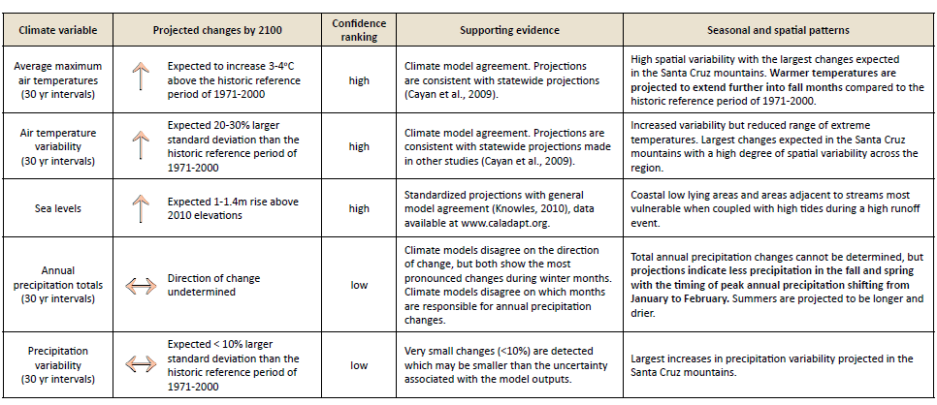


Slide 61
Potential Implications of Climate Change for Santa Cruz’s Water Supply
Probable increased variability overall,
Probable increased frequency of drought, and
Probable changes in precipitation patterns

Slide 62
Implications of Potential Source of Supply Changes on
Source Characteristics

Slide 63

Watershed Impacts on Water Quality:
Coliform/Bacteria
TOC TTHM
Sludge Processing
Sand Removal

Slide 64
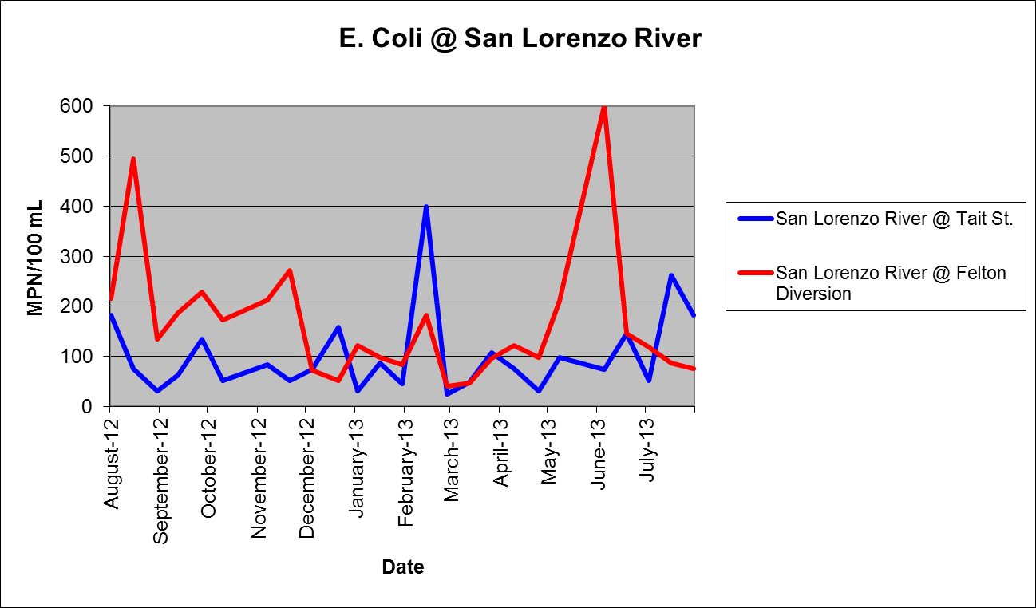
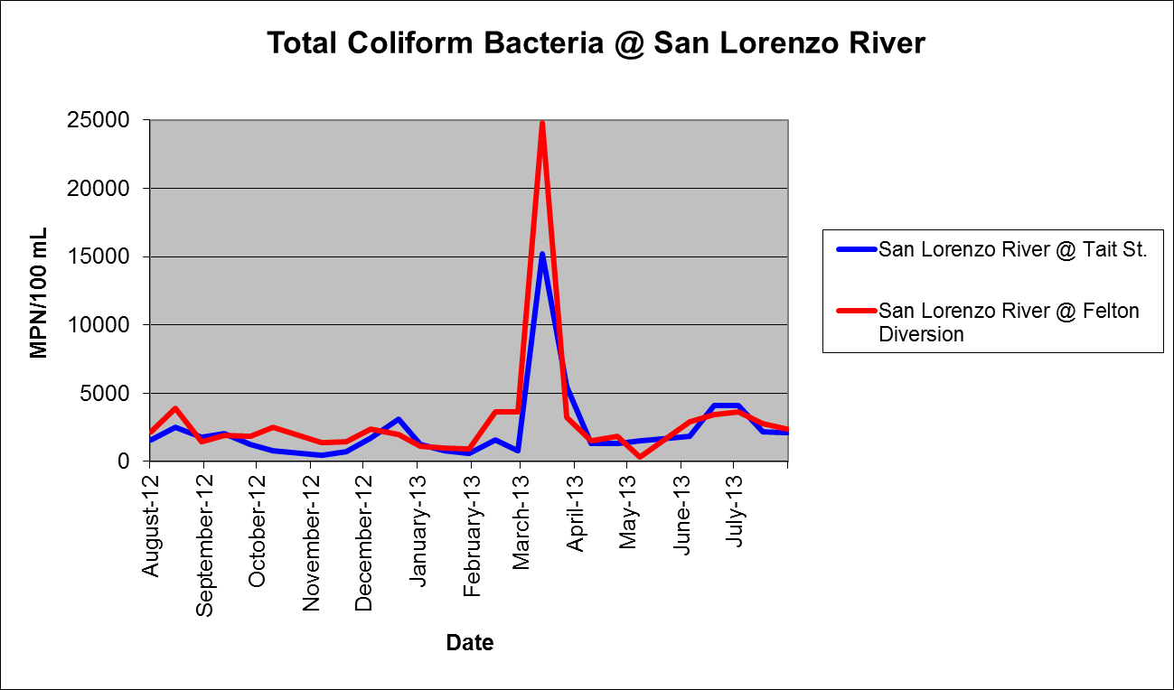

Slide 65
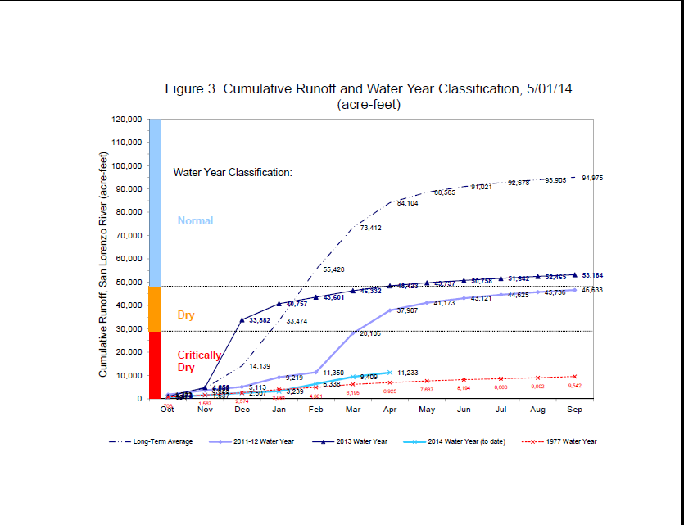

Slide 66


Water Sources
Tait Wells
Loch Lomond Reservoir (1960)
Loch
3%
North Coast
Lomond
Streams
North Coast Streams (1890)
TOC: 4-6 mg/L
22%
25%
TOC: <1mg/L
Beltz Wells (1964)
Beltz Wells
San Lorenzo River (1924)
4%
TOC: 0 mg/L
TOC: 2-4 mg/L
( >10 During High Flows)
San Lorenzo
River
46%

Slide 67


THM Source Formation Potentials
25%
MCL
80 ppb
24%
47%
Reservoir
River/Stream
TTHM’s
TTHM’s
140 ppb
70 ppb

Slide 68
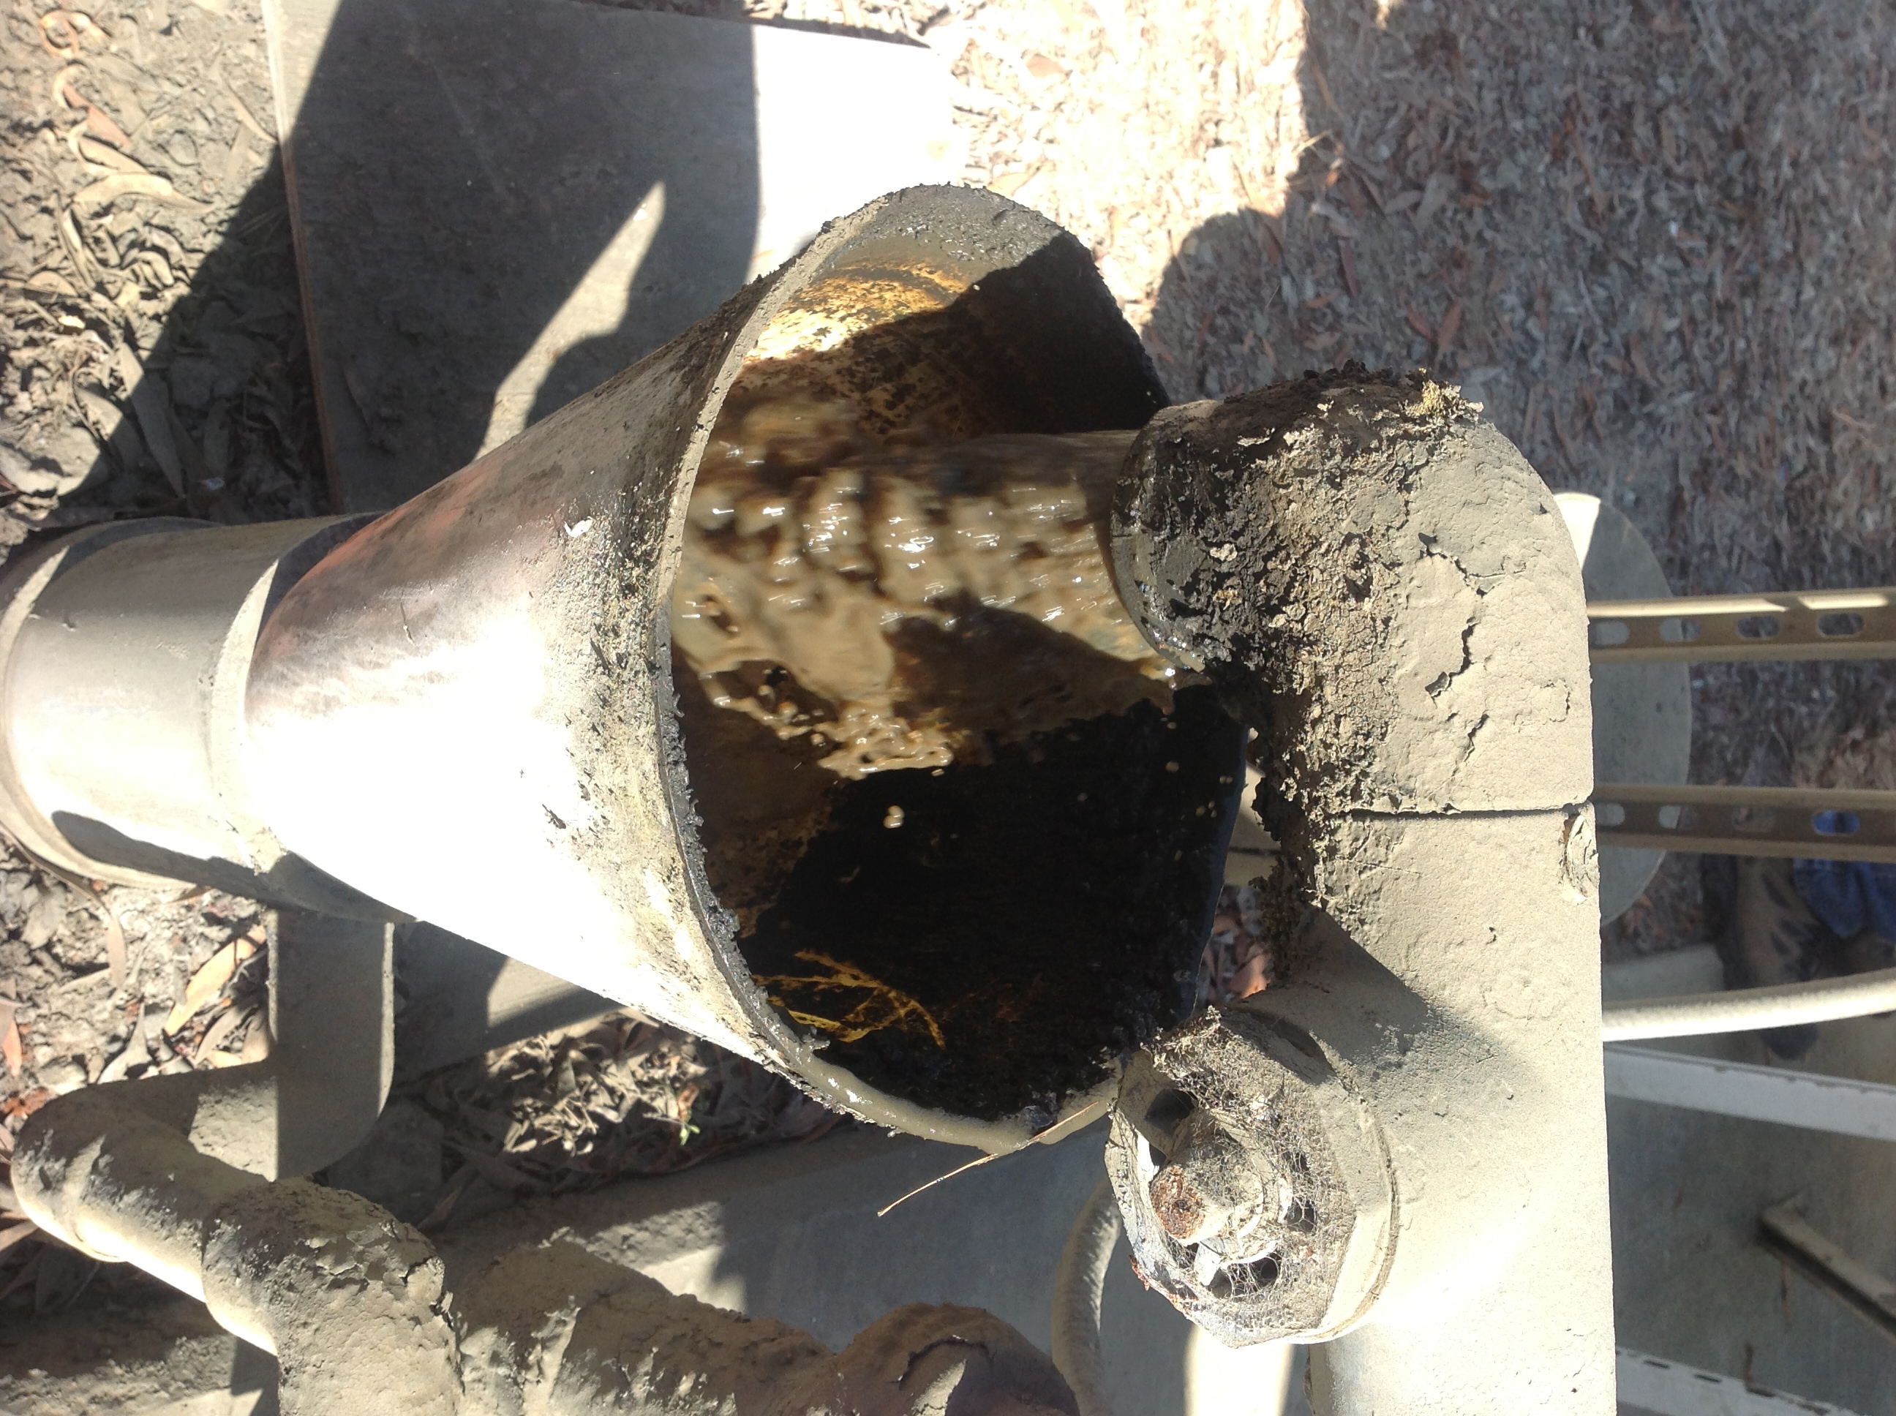
GHWTP sludge discharge to the sanitary sewer

Slide 69
Future Demand

Slide 70
How We Estimate Demand
Major Inputs, Methodologies, and Source Reference
Major inputs:
  Population forecasts (AMBAG)
  Growth in number of accounts for each class of customers (calculated based on population)
  Water use in future development (developed based on recent actual experience)
Selected methodology comes from the AWWA M50 Manual: Water Resources Planning
Price hasn’t been formally factored into projections but obviously has an impact and needs to be considered.

Slide 71
2010 Urban Water Management Plan
Demand Forecasts*
Used population forecasts created by the Association of Monterey Bay Area Governments
Were created using one method for customers inside Santa Cruz and another for those living outside Santa Cruz
The inside Santa Cruz forecast was developed to align with the Santa Cruz 2030 General Plan
Included 2 scenarios – Scenario 1 based on higher per account water use levels during 1999 to 2004, and Scenario 2 based on the lower per account water use levels occurring during 2007 and 2008
* For a more detailed description of the methodology, please see http://www.cityofsantacruz.com/Modules/ShowDocument.aspx?documentid=24687

Slide 72
Demand Projection from the
2010 Urban Water Management Plan
Water Demand Forecast Scenario 2, Table 4-11

Slide 73
2010 Urban Water Management Plan Table 4-11: Water Demand Forecast, Scenario 2 (a)
Location: | Customer Class | 2010 | 2015 | 2020 | 2025 | 2030
City of Santa Cruz | Single Residential | 839 | 854 | 869 | 884 | 899
 | Multiple Residential | 408 | 424 | 440 | 456 | 472
 | Business/Industry | 425 | 454 | 483 | 511 | 540
 | Municipal | 54 | 54 | 55 | 55 | 56
 | Irrigation/Golf | 115 | 118 | 120 | 122 | 125
 | UC Santa Cruz | 212 | 276 | 339 | 344 | 349
Inside City Subtotal (millions of gallons) |  | 2,055 | 2,180 | 2,306 | 2,373 | 2,441
Outside City: County, Capitola, & North Coast Irrigation | Single Residential | 502 | 513 | 523 | 533 | 543
 | Multiple Residential | 336 | 343 | 350 | 357 | 364
 | Business/Industry | 231 | 236 | 240 | 245 | 250
 | Municipal | - | - | - | - | -
 | Irrigation/Golf | 130 | 133 | 135 | 138 | 141
Outside City Subtotal (millions of gallons) |  | 1,199 | 1,224 | 1,248 | 1,273 | 1,297
Other miscellaneous uses including water losses |  | 268 | 280 | 292 | 300 | 307
Total System Water Demand (millions of gallons) |  | 3,522 | 3,684 | 3,847 | 3,946 | 4,046
Notes:
(a) Assumes existing (2010) water demands recover to 2007-08 levels

Slide 74
Price Elasticity of Demand*
Measures the responsiveness of the quantity of water demanded to a change in price;
For example, a 15% rate increase with a -0.3 elasticity would result in a 4.5% reduction in demand;
Measured price elasticities of demand between 0 and -1 are referred to as “relatively” inelastic because the percentage change in quantity is less than the percentage change in price.
* From Forecasting Urban Water Demand, R. Bruce Billings and Clive V. Jones; Second Edition, AWWA 2008

Slide 75
Price Elasticity of Water Demand – Elasticity Factors
 | Marginal Price in Rate Structure
 | Uniform Rates | Increasing Block Rates
Base case elasticity | -0.4 | -0.5
Additions or Subtractions
Marginal price on bills | -0.1 | -0.15
Wet/cold climate | +0.1 | +0.1
Arid West | -0.1 | -0.1
Winter (low irrigation season) | +0.15 | +0.15
Summer (high irrigation season) | -0.15 | -0.15
Bills > 1.5% of average income | -0.1 | -0.1
Bills < 0.5% of average income | +0.2 | +0.2
Effective Long Term Conservation | +0.1 | +0.1
Adapted from Table 9-5, Second Edition, Forecasting Urban Water Demand, R. Bruce Billings and Clive V. Jones, AWWA 2008

Slide 76
Santa Cruz’s Current Water Rates:
Fixed Water Rate Charges Based on Meter Size and Volume Rates for SFR and Duplex Customers
Meter Size | Inside City (Monthly) | Outside City (Monthly)
5/8" and 3/4" | $17.41 | $22.20
1” | 43.52 | 55.50
1-1/2” | 87.05 | 110.98
2” | 139.27 | 177.57
3” | 261.14 | 332.95
4” | 435.23 | 554.92
6” | 870.46 | 1,109.83
8” | 2,002.05 | 2,553.34
10" | 2,472.09 | 3,151.92
Single-Family and Duplex Residential Customers
Units per billing period | Inside-City | Outside-City
1-4 ccf | $1.57 | $2.00
5-9 ccf | 4 | 5.1
10-14 ccf | 5.14 | 6.55
15-18 ccf | 7.05 | 8.98
Over 18 ccf | 8.79 | 11.21
Note: All other customers pay a uniform rate of $4 per ccf inside the city or $5.10 per ccf outside the city

Slide 77
Price Elasticity for Santa Cruz
Using the elasticity factors from the elasticity table, single family/duplex residential elasticity would be:
  Summer elasticity (with long term conservation): -0.55
  Winter elasticity (with long term conservation): -0.25
Using the elasticity factors from the previous slide, elasticity for all other customers would be:
  Summer elasticity (with long term conservation): -0.45
  Winter elasticity (with long term conservation): -0.15

Slide 78
If price were the only factor… what does history tell us about the potential elasticity of demand in Santa Cruz?
Between 2004 and 2008, demand, as measured by gross production, fell by 9%;
Between 2004 and the end of 2008 a series of rate increase totaling 82.5% was implemented (June 2004: 25%, January 2005 through 2008 20%, 15%, 12.5% and 10% respectively);
Actual rates for this period more than doubled (113.5%) due to compounding;
If no other variables, such as weather, influenced demand, and demand changed only due to price, the elasticity of demand for this period would be -0.11 for an 82.5% rate increase or -0.08% for the 113.5% rate increase

Slide 79
Long Term Water Conservation Master Plan
Note: The Long Term Conservation Master Plan described in this presentation is a work in progress. Several slides in this part of the presentation show analytical results that are based on certain assumptions that may change over time. The purpose of including these slides is to demonstrate the analytical approaches that can be used in considering additional conservation measures rather than present final analyses and/or recommendations.

Slide 80
How efficient are fixtures in the residential, commercial, and landscape sectors?
Preliminary Results Water Use Baseline Survey
 | SFR | MFR
Toilets | 90% | 91%
Showerheads | 92% | 98%
Bathroom Faucets | 90% | 82%
Kitchen Faucets | 71% | 82%
Clothes Washers | 63% | 46%
Notes:
Toby
MFR – in-unit versus and common area laundries (separate data). >50% in common area machines were HECW
Future discussion on Saturation Study – HECW in unit efficiency ratings.

Slide 81
Conservation Measure Screening
All Potential Measures Identified
Staff, Public, Consultant, and
Water Commission Input
90+ Measures Identified
Measures Screened
Staff and Consultants Screen Measures with Decision Criteria
39 Feasible Measures Remain
Measures Evaluated in the DSS Model
Notes:
Flow of information

Slide 82
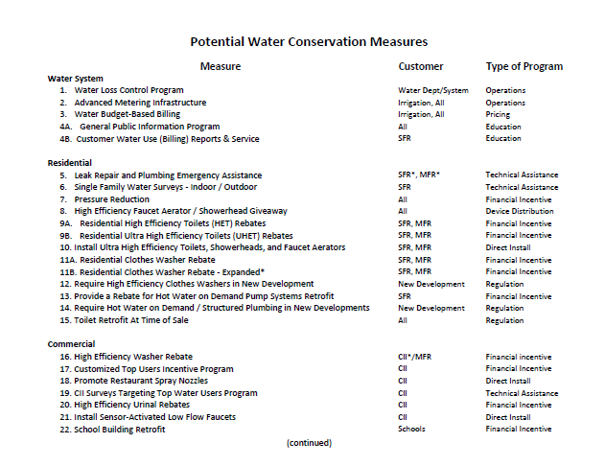

Slide 83
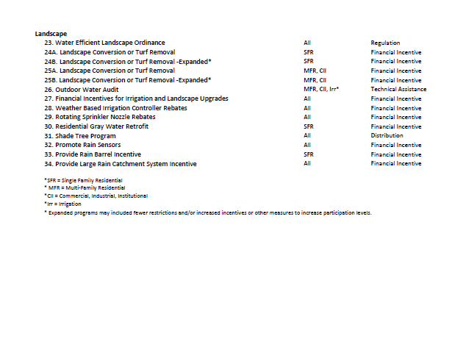
Water Conservation Measures

Slide 84
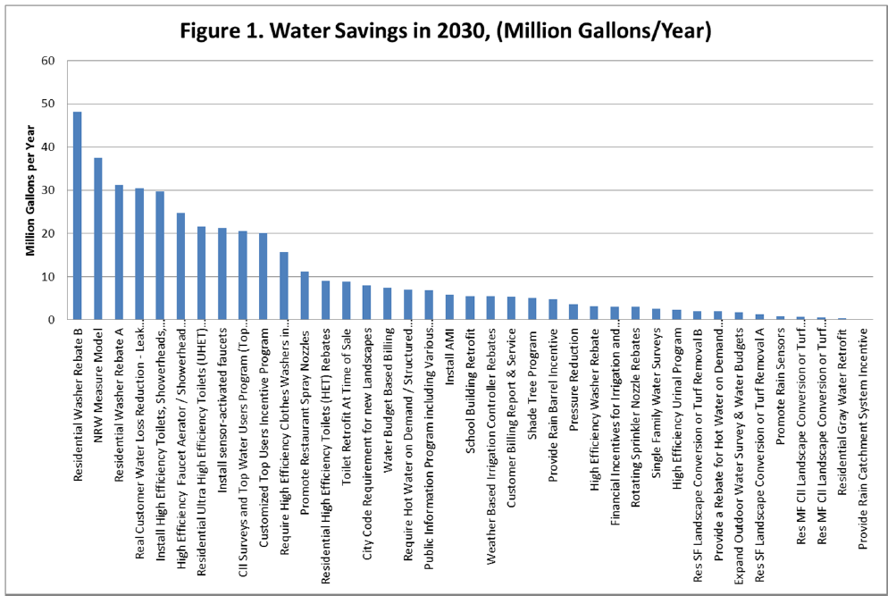
Projected Water Savings

Slide 85
To assist in program evaluation, four conservation program plans were developed
Education and Mandates will be included in the Plan
Focusing on what levels of additional conservation measures are worth investing in for the next 10-20 years?
  Program A – “Current Program”
  Program B – “Customer Service & Cost Effective”
  Program C – “Optimized to Maximize Savings”
  Program D – “All Measures” (without exceeding saturation)

Slide 87
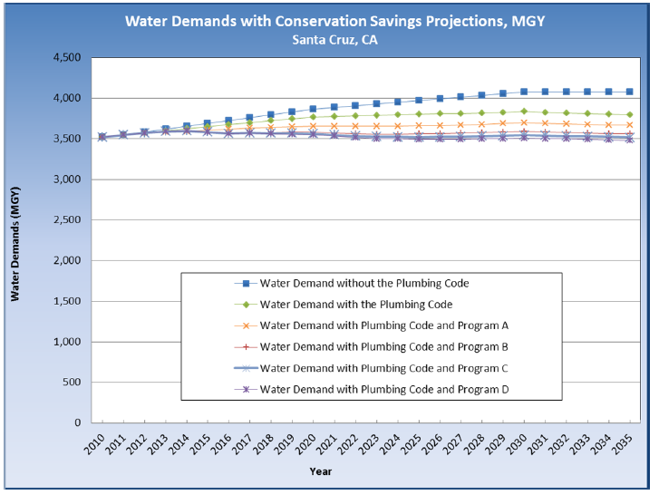
Water Demands with
Conservation Savings Projections

Slide 88
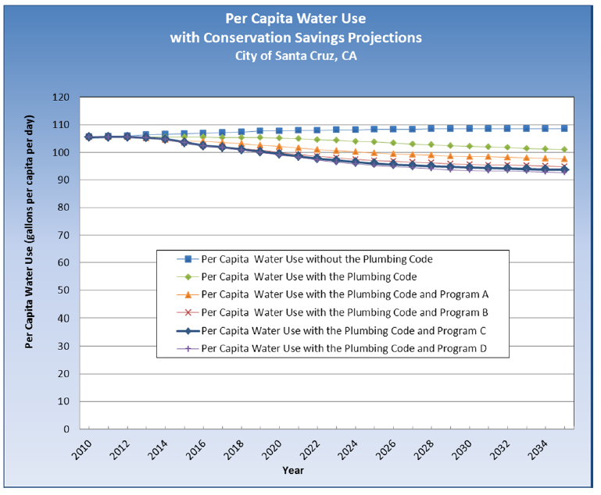
Per Capita Water Use with Conservation Savings Projections

Slide 89
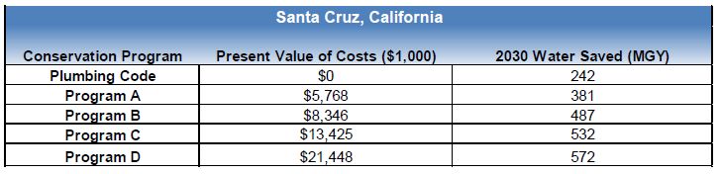
Comparison of Programs

Slide 90
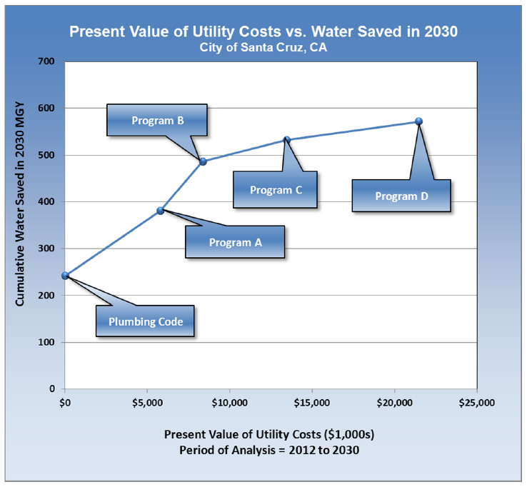

Slide 91
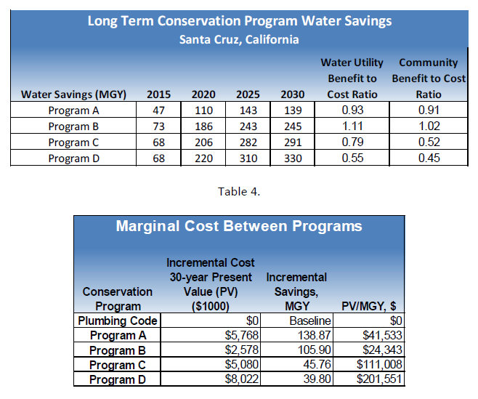

Slide 92
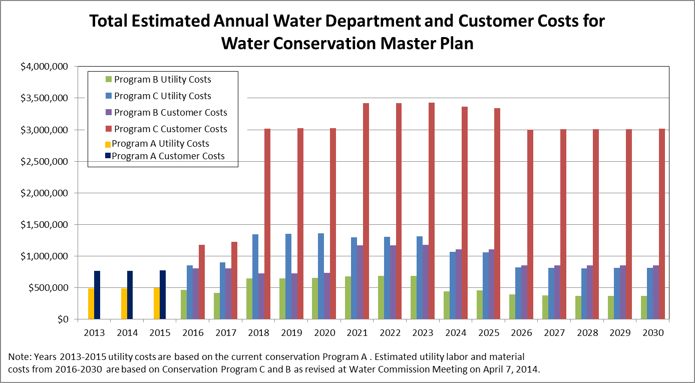
Program B vs. C
Program Implementation Costs
Notes:
TOBY

Slide 93
Conclusion and Take Aways

Slide 94
Conclusion and Take Aways
Lots of opportunity to discuss and disagree about what are the right assumptions about future demand, but there is no guaranteed right answer;
Climate change introduces irreducible uncertainty into our process – ultimately we’ll have to figure out how to take this uncertainty into account in our planning, but we aren’t likely to find ways to resolve it; and
Scenario planning is a useful way to learn about and get a better handle on how the various factors we’re dealing with in our planning could affect our future.

Slide 95
The End
(Thank Heavens!)

